Slide 1
Western National Range CDE Plants
Forbs, Woody Plants, & Noxious Weeds
These slides are in alphabetical order as listed in the event manual for this CDE.
In slideshow presentation mode, the slide will initially show up without name or characteristics. Once you click, the name and characteristics will appear.
Study tip: If helping students study for this CDE, rearrange the slides to help prevent memorization of the order.

Slide 2
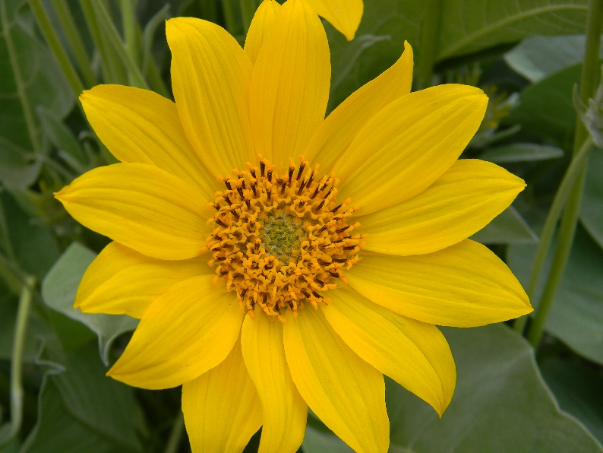
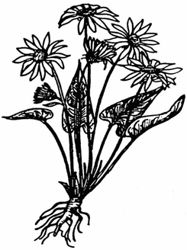
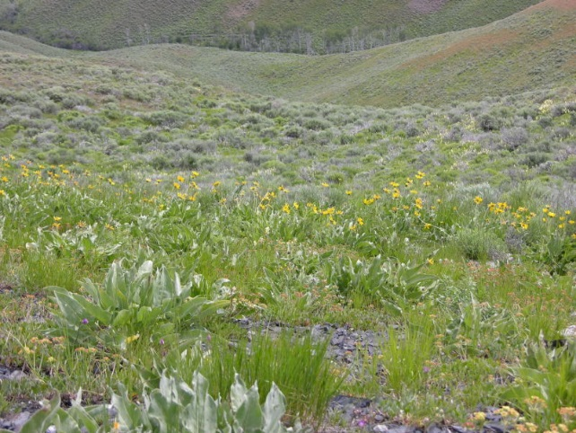
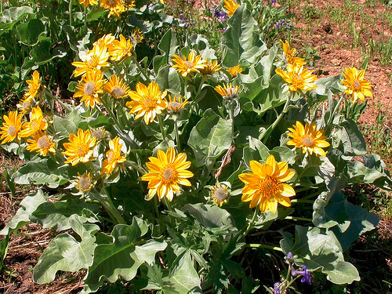
Arrowleaf Balsamroot Forb
Perennial
Native
Desirable for Grazers
Desirable for Browsers
USDA Plants Database
Josh Corbett
Connor White
Matt Lavin – flickr.com

Slide 3
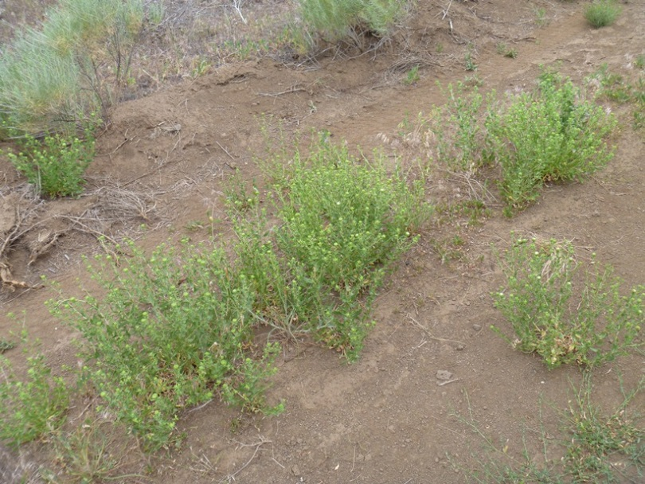
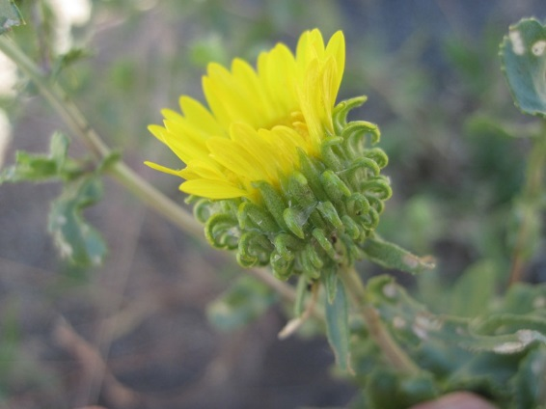
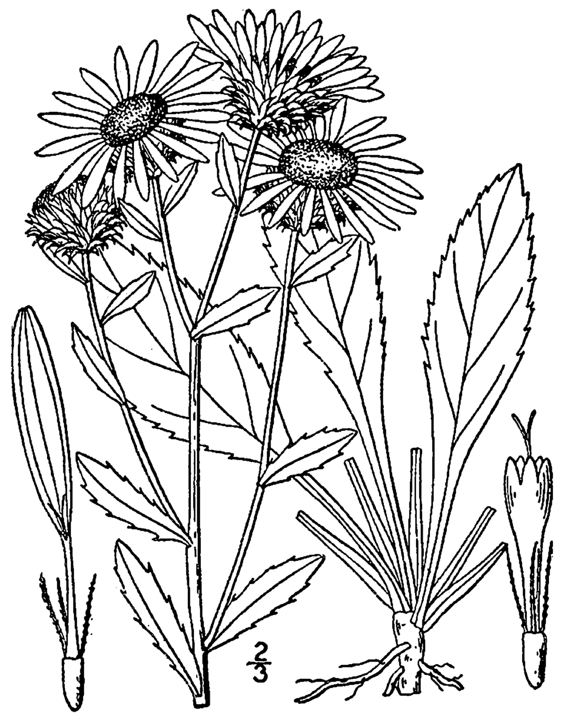
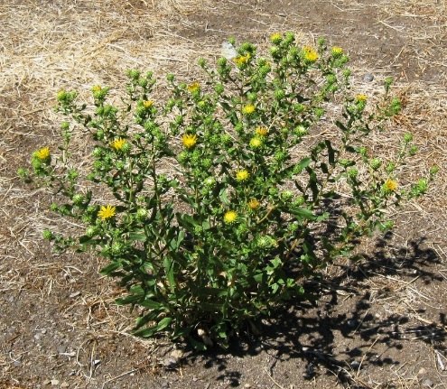
Curlycup Gumweed Forb
Perennial
Native
Undesirable for Grazers
Undesirable for Browsers
Connor White
Jen Peterson
K. Launchbaugh
USDA Plants Database

Slide 4
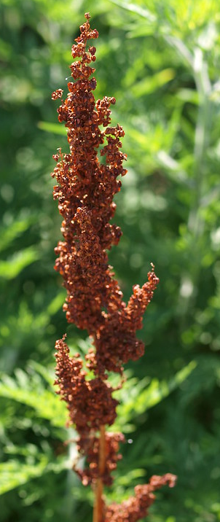
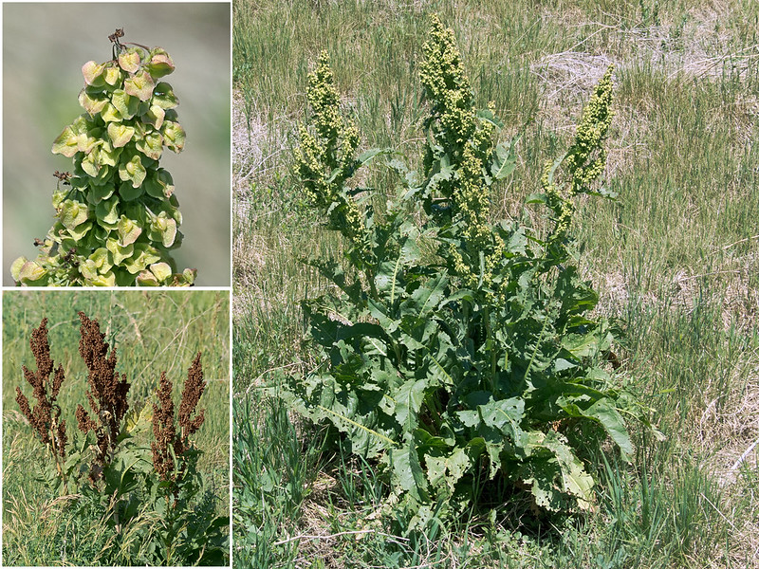
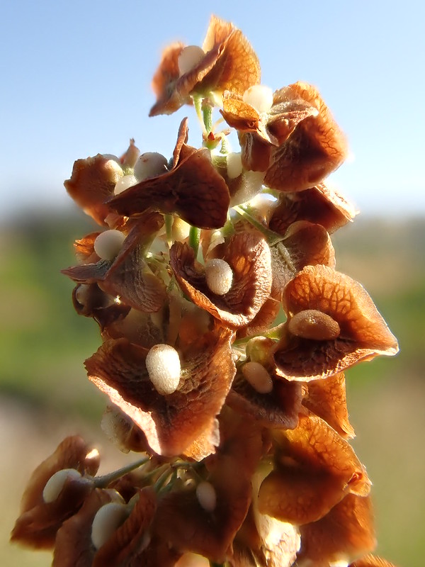
Curly Dock Nevada Forb
Perennial
Introduced
Undesirable for Grazers
Undesirable for Browsers
Toxic
Nature80020-flicr.com
Matt Lavin-flicr.com
F..D Richards – flickr.com

Slide 5
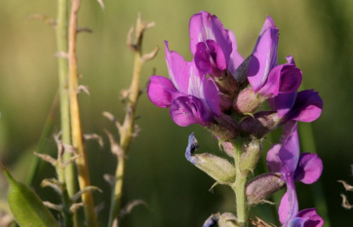
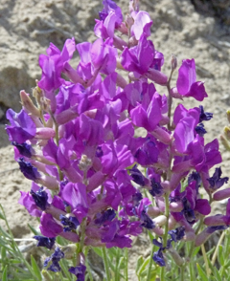
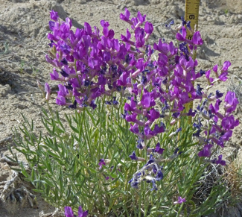
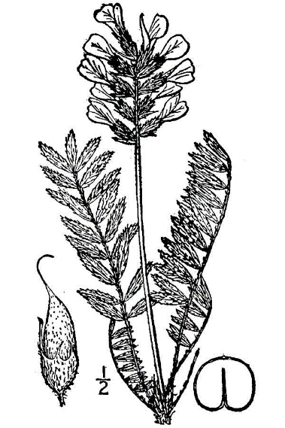
Locoweed Forb
Perennial
Native
Undesirable for Grazers
Undesirable for Browsers
Toxic
Matt Lavin – flickr.com
Matt Lavin – flickr.com
Matt Lavin – flickr.com
USDA Plants Database

Slide 6
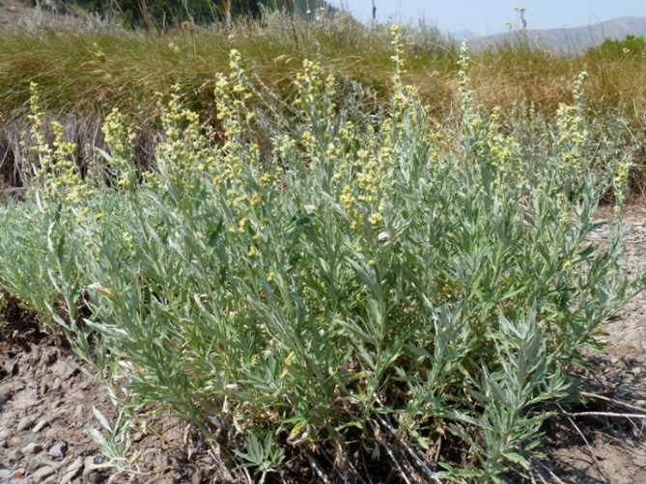
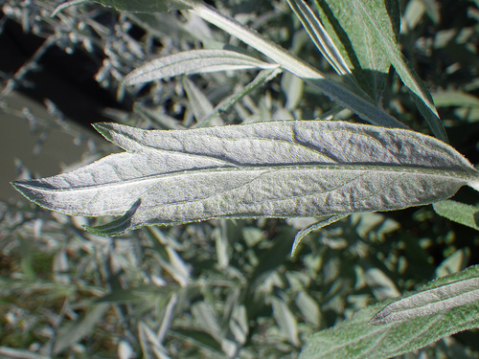
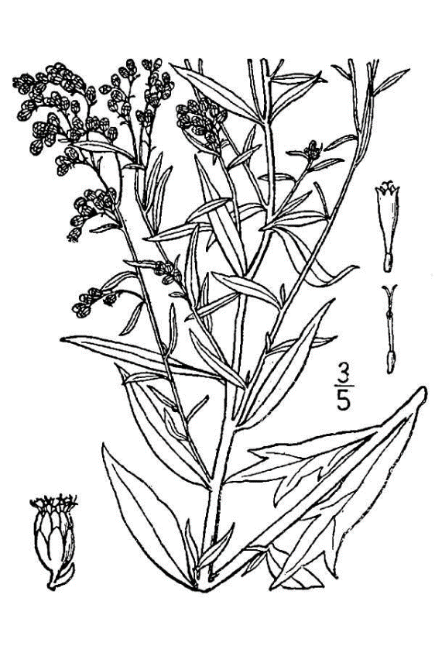
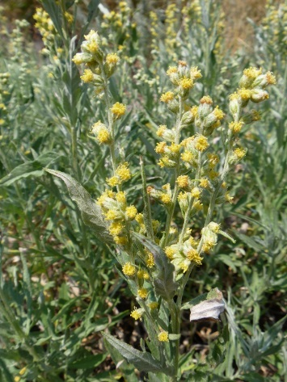
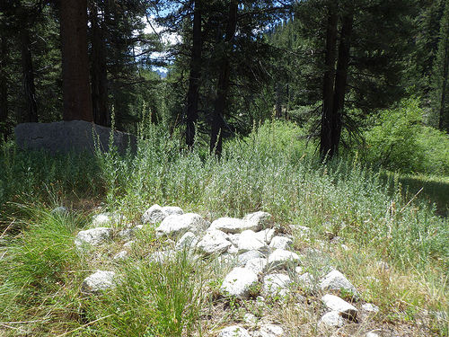
Louisiana Sage or Cudweed Sagewort Forb
Perennial
Native
Undesirable for Grazers
Undesirable for Browsers
Matt Lavin – flickr.com
Matt Lavin – flickr.com
Connor White
Matt Lavin – flickr.com
Matt Lavin – flickr.com
USDA Plants Database

Slide 7
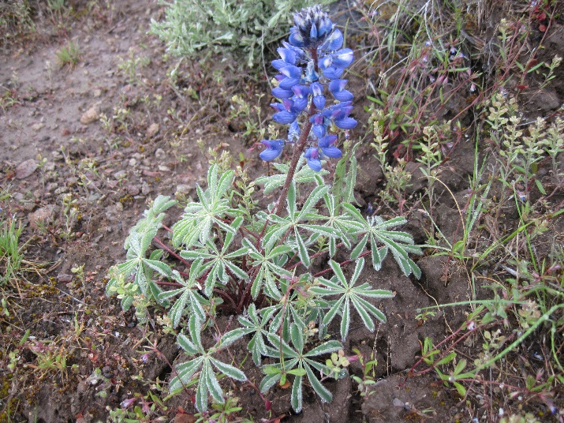
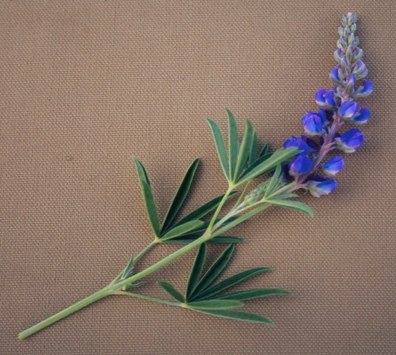
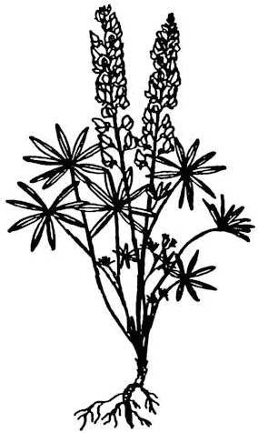
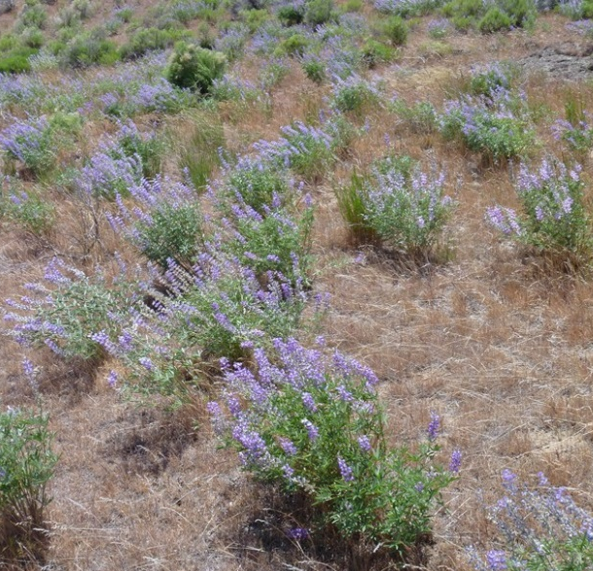
Lupine Forb
Perennial
Native
Undesirable for Grazers
Undesirable for Browsers
Toxic
Jen Peterson
Noel Winegart
Jen Peterson
USDA Plants Database

Slide 8
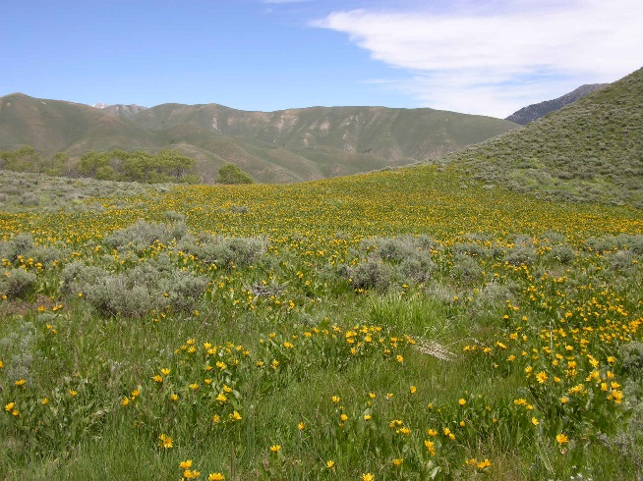
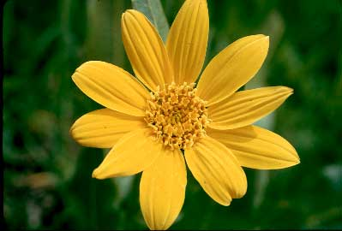
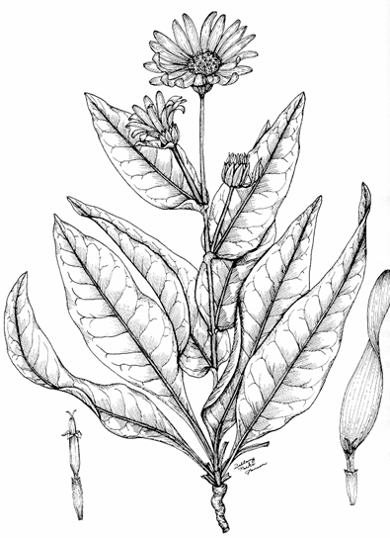
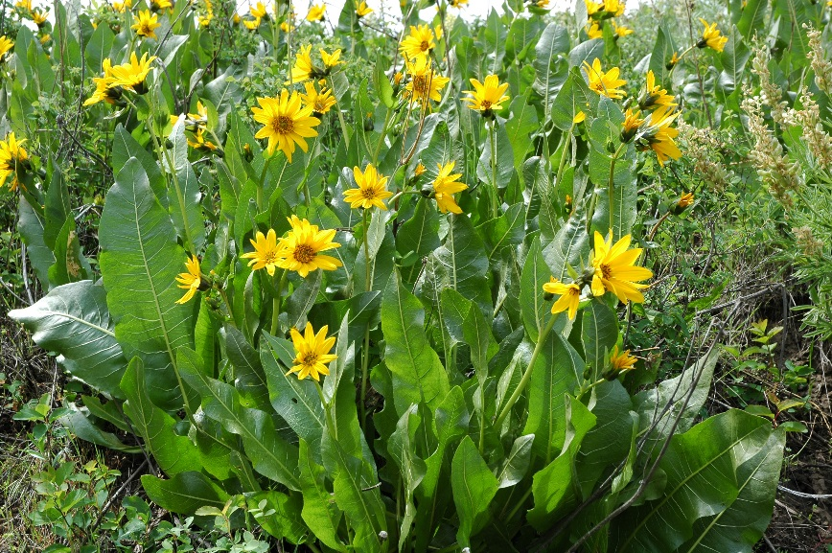
Mule-ears Forb
Perennial
Native
Undesirable for Grazers
Undesirable for Browsers
Noel Winegart
Jen Peterson
Jen Peterson
USDA Plants Database

Slide 9
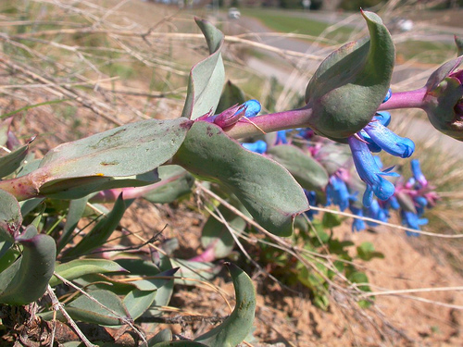
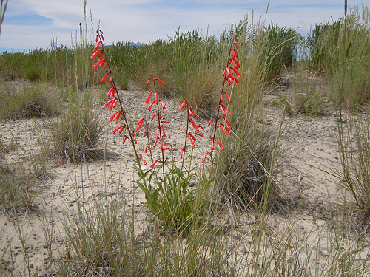
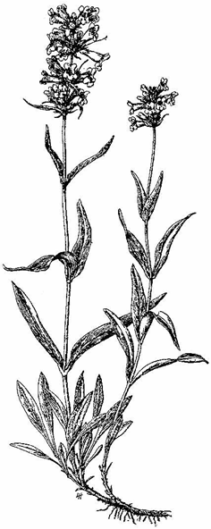
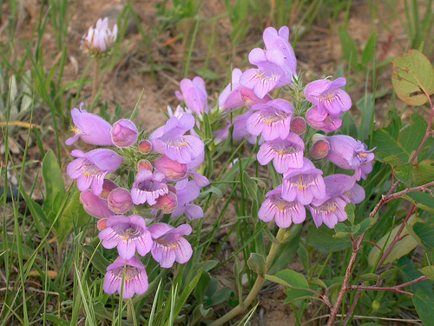
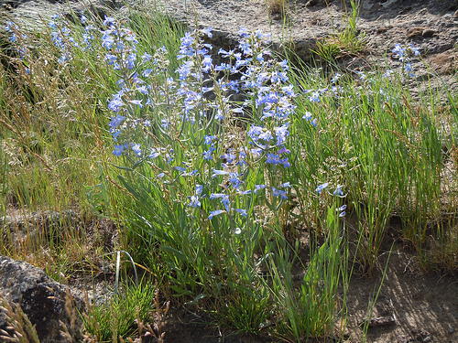
Penstemon or Beardtongue Forb
Perennial
Native
Undesirable for Grazers
Desirable for Browsers
Matt Lavin – flickr.com
Matt Lavin – flickr.com
USDA Plants Database
Matt Lavin – flickr.com
Matt Lavin – flickr.com

Slide 10
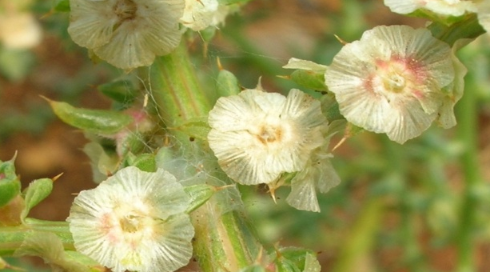
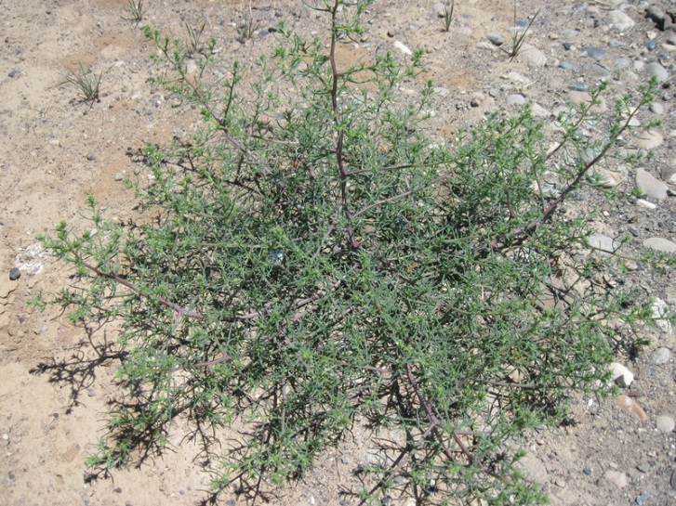
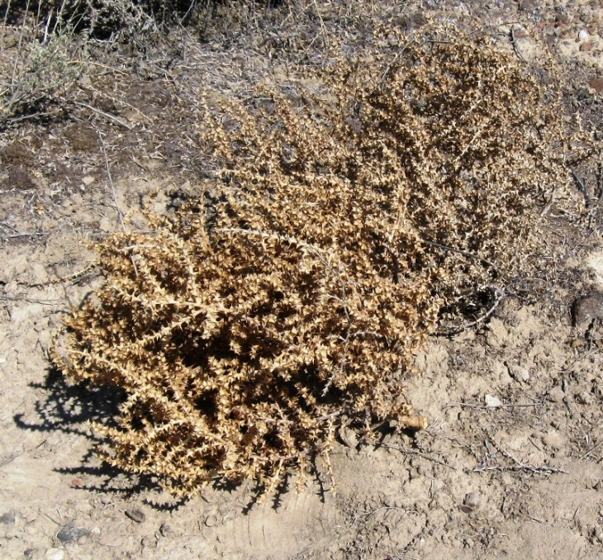
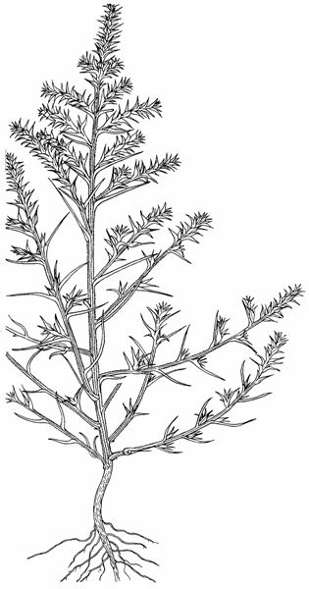
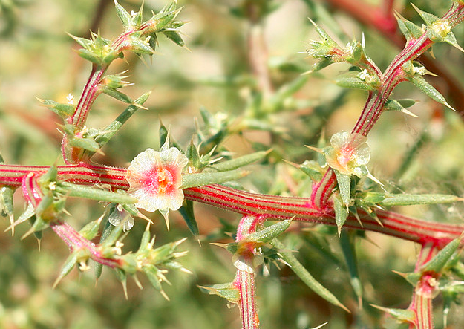
Russian Thistle or Tumbleweed Forb
Annual
Introduced
Undesirable for Grazers
Undesirable for Browsers
Toxic
Connor White
Connor White
Connor White
Lynette Schimming – Flickr.com
USDA Plants Database

Slide 11
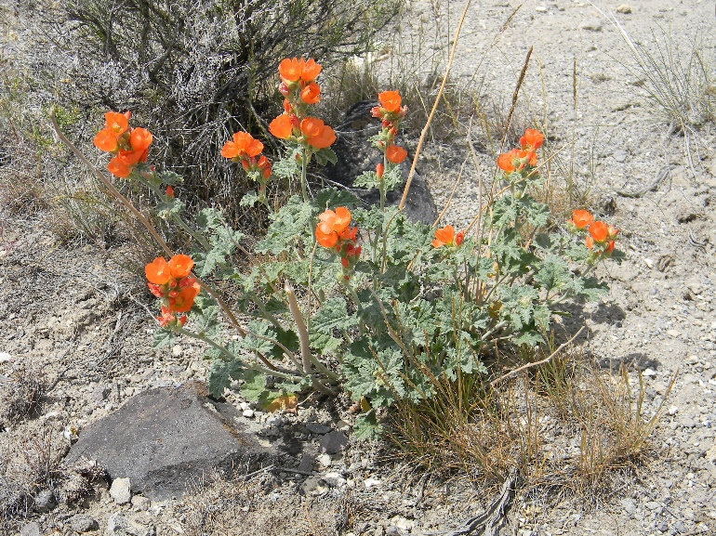
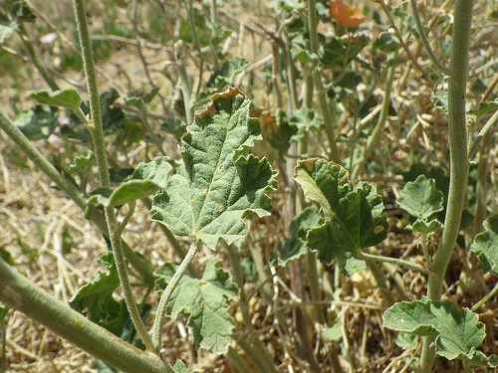
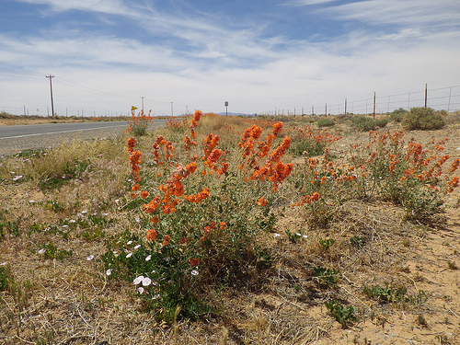
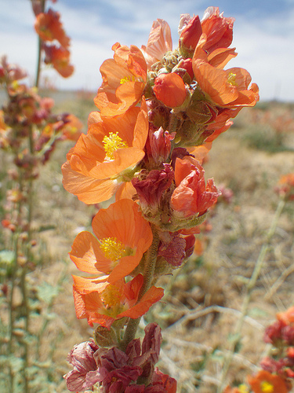
Scarlet Globemallow Forb
Perennial
Native
Desirable for Grazers
Desirable for Browsers
Josh Corbett
Matt Lavin – flickr.com
Matt Lavin – flickr.com
Matt Lavin – flickr.com

Slide 12
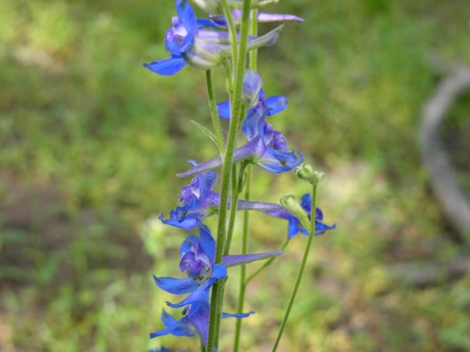
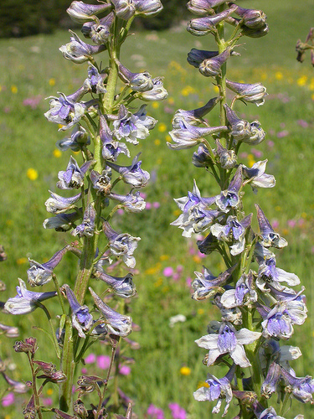
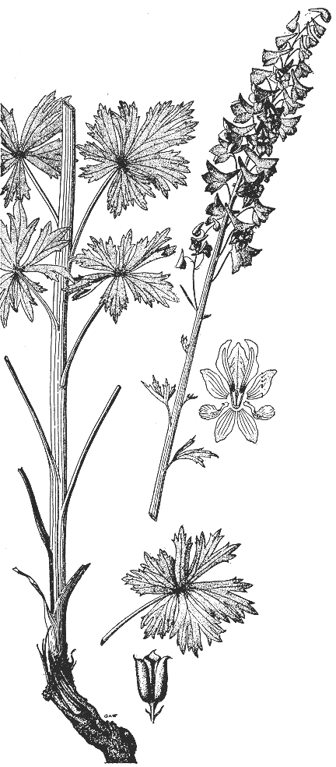
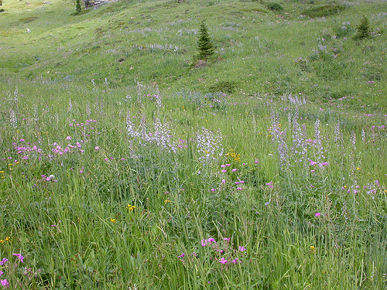
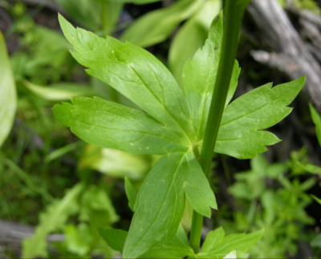
Tall Larkspur Forb
Perennial
Native
Undesirable for Grazers
Undesirable for Browsers
Toxic
Jen Peterson
Matt Lavin – flickr.com
Jen Peterson
USDA Plants Database
Matt Lavin – flickr.com

Slide 13
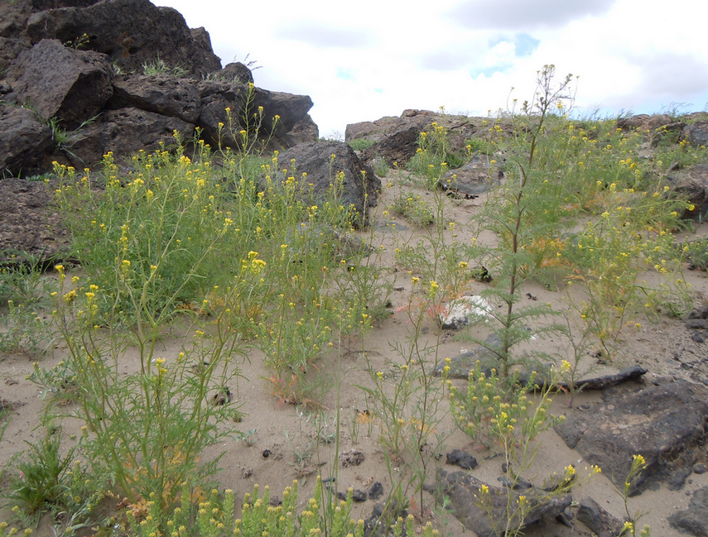
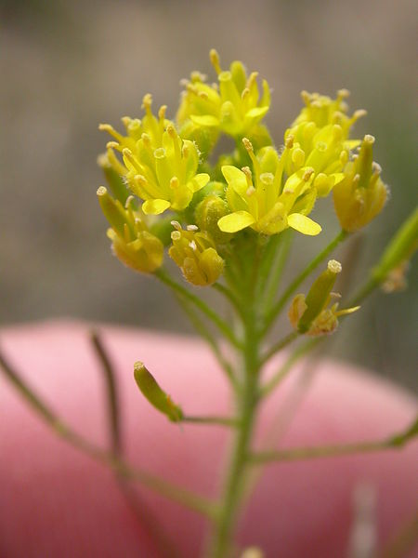
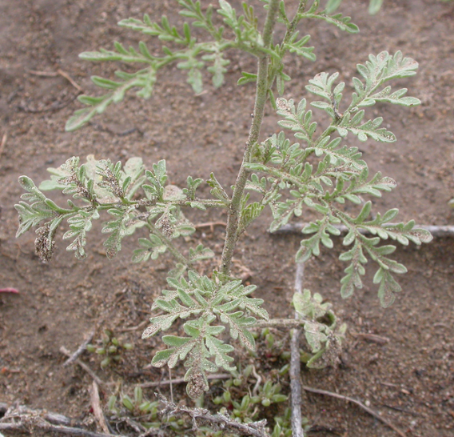


Tansymustard Forb
Annual
Native
Undesirable for Grazers
Desirable for Browsers
Matt Lavin – flickr.com
Matt Lavin – flickr.com
Matt Lavin – flickr.com
Matt Lavin – flickr.com
Matt Lavin – flickr.com

Slide 14





Tapertip Hawksbeard Forb
Perennial
Native
Desirable for Grazers
Desirable for Browsers
Jen Peterson
Matt Lavin – flickr.com
USDA Plants Database
Matt Lavin – flickr.com
Matt Lavin – flickr.com

Slide 15





Western Yarrow Forb
Perennial
Native
Undesirable for Grazers
Desirable for Browsers
Jen Peterson
Jen Peterson
Jen Peterson
Jen Peterson
USDA Plants Database

Slide 16




Antelope Bitterbrush Woody
Perennial
Native
Desirable for Grazers
Desirable for Browsers
K. Launchbaugh
Jen Peterson
K. Launchbaugh
USDA Plants Database

Slide 17





Big Sagebrush Woody
Perennial
Native
Undesirable for Grazers
Desirable for Browsers
K. Launchbaugh
Matt Lavin – flickr.com
Matt Lavin – flickr.com
Matt Lavin – flickr.com
USDA Plants Database

Slide 18




Chokecherry Woody
Perennial
Native
Undesirable for Grazers
Undesirable for Browsers
Toxic
K. Launchbaugh
USDA Plants Database
Lovina Roselle
Lovina Roselle

Slide 19




Coyote Willow Woody
Perennial
Native
Desirable for Grazers
Desirable for Browsers
K. Launchbaugh
K. Launchbaugh
K. Launchbaugh
USDA Plants Database

Slide 20




Curl-leaf Mountain Mahogany Woody
Perennial
Native
Undesirable for Grazers
Desirable for Browsers
K. Launchbaugh
K. Launchbaugh
Karen Launchbaugh
Matt Lavin – flickr.com
Matt Lavin – flickr.com

Slide 21




Fourwing Saltbush Woody
Perennial
Native
Desirable for Grazers
Desirable for Browsers
Connor White
Connor White
Connor White
Matt Lavin – flickr.com

Slide 22




Gambel Oak Woody
Perennial
Native
Undesirable for Grazers
Undesirable for Browsers
Toxic
USDA Plants Database
Bryant Olsen – flickr.com
USDA Plants Database
USDA Plants Database

Slide 23



Gray or Spineless Horsebrush Nevada Woody
Perennial
Native
Undesirable for Grazers
Undesirable for Browsers
Toxic
Matt Lavin – flickr.com
Matt Lavin – flickr.com
Matt Lavin – flickr.com

Slide 24




Greasewood Woody
Perennial
Native
Undesirable for Grazers
Undesirable for Browsers
Toxic
Matt Lavin – flickr.com
Matt Lavin – flickr.com
Connor White
Matt Lavin – flickr.com

Slide 25




Mormon Tea Woody
Perennial
Native
Desirable for Grazers
Desirable for Browsers
Grand Canyon National Park
Grand Canyon National Park
Jen – flickr.com
Grand Canyon National Park

Slide 26




Pinyon Pine Woody
Perennial
Native
Undesirable for Grazers
Desirable for Browsers
Dave Skinner– flickr.com
Utah State University
Utah State University
Dave Skinner– flickr.com

Slide 27





Quaking Aspen Woody
Perennial
Native
Undesirable for Grazers
Desirable for Browsers
Matt Lavin – flickr.com
Jen Peterson
Matt Lavin – flickr.com
Karen Launchbaugh
Matt Lavin – flickr.com
Matt Lavin – flickr.com
USDA Plants Database

Slide 28






Rabbitbrush (Green or Rubber) Woody
Perennial
Native
Undesirable for Grazers
Undesirable for Browsers
Connor White
Connor White
USDA Plants Database
Connor White
Connor White
USDA Plants Database

Slide 29




Redosier Dogwood Woody
Perennial
Native
Undesirable for Grazers
Desirable for Browsers
Matt Lavin – flickr.com
Karen Launchbaugh
Matt Lavin – flickr.com
Matt Lavin – flickr.com
Matt Lavin – flickr.com

Slide 30





Saskatoon Serviceberry Woody
Perennial
Native
Desirable for Grazers
Desirable for Browsers
Matt Lavin – flickr.com
Josh Corbett
Josh Corbett
Matt Lavin – flickr.com
Matt Lavin – flickr.com
USDA Plants Database

Slide 31




Shadscale Woody
Perennial
Native
Desirable for Grazers
Desirable for Browsers
Jen Peterson
Jen Peterson
Jen Peterson
USDA Plants Database

Slide 32




Skunkbrush Sumac Woody
Perennial
Native
Undesirable for Grazers
Desirable for Browsers
Stan Shebs – northwestplants.com
Matt Lavin – flickr.com
Stan Shebs – sagebud.org
Matt Lavin – flickr.com

Slide 33




Spiny Hopsage Nevada Woody
Perennial
Native
Undesirable for Grazers
Desirable for Browsers
Matt Lavin – flickr.com
Matt Lavin – flickr.com
Matt Lavin – flickr.com
Matt Lavin – flickr.com

Slide 34




Winterfat Woody
Perennial
Native
Desirable for Grazers
Desirable for Browsers
K. Launchbaugh
K. Launchbaugh
Jen Peterson
USDA Plants Database

Slide 35



Woods’ Rose Woody
Perennial
Native
Undesirable for Grazers
Desirable for Browsers
Jen Peterson
Noel Winegard
Noel Winegard

Slide 36





Canada Thistle Forb
Perennial
Introduced
Undesirable for Grazers
Undesirable for Browsers
Matt Lavin – flickr.com
Matt Lavin – flickr.com
Matt Lavin – flickr.com
Matt Lavin – flickr.com
USDA Plants Database

Slide 37





Cheatgrass or Downy Brome Grass
Annual
Introduced
Undesirable for Grazers
Undesirable for Browsers
Matt Lavin – flickr.com
Matt Lavin – flickr.com
Matt Lavin – flickr.com
Matt Lavin – flickr.com
USDA Plants Database

Slide 38




Halogeton Forb
Annual
Introduced
Undesirable for Grazers
Undesirable for Browsers
Toxic
Matt Lavin – flickr.com
Matt Lavin – flickr.com
Matt Lavin – flickr.com
Matt Lavin – flickr.com

Slide 39




Hoary Cress or Whitetop Forb
Perennial
Introduced
Undesirable for Grazers
Undesirable for Browsers
Matt Lavin – flickr.com
Matt Lavin – flickr.com
Matt Lavin – flickr.com
USDA Plants Database

Slide 40




Leafy Spurge Forb
Perennial
Introduced
Undesirable for Grazers
Undesirable for Browsers
K. Launchbaugh
K. Launchbaugh
Matt Lavin – flickr.com
Matt Lavin – flickr.com

Slide 41





Poison Hemlock Forb
Perennial
Introduced
Undesirable for Grazers
Undesirable for Browsers
Toxic
Matt Lavin – flickr.com
Matt Lavin – flickr.com
Matt Lavin – flickr.com
Matt Lavin – flickr.com
Matt Lavin – flickr.com

Slide 42




Medusahead Rye Grass
Annual
Introduced
Undesirable for Grazers
Undesirable for Browsers
Steve Dewey, Utah State University, bugwood.org
USDA Plants Database
Matt Lavin – flickr.com
Matt Lavin – flickr.com

Slide 43




Salt Cedar Woody
Perennial
Introduced
Undesirable for Grazers
Undesirable for Browsers
Matt Lavin – flickr.com
Matt Lavin – flickr.com
Matt Lavin – flickr.com
Oregon State University

Slide 44





Spotted Knapweed Forb
Perennial
Introduced
Undesirable for Grazers
Undesirable for Browsers
Matt Lavin – flickr.com
Matt Lavin – flickr.com
Matt Lavin – flickr.com
Matt Lavin – flickr.com
USDA Plants Database

Slide 45




Ventenata Grass
Annual
Introduced
Undesirable for Grazers
Undesirable for Browsers
Matt Lavin – flickr.com
Matt Lavin – flickr.com
Matt Lavin – flickr.com
Matt Lavin – flickr.com

