Slide 1
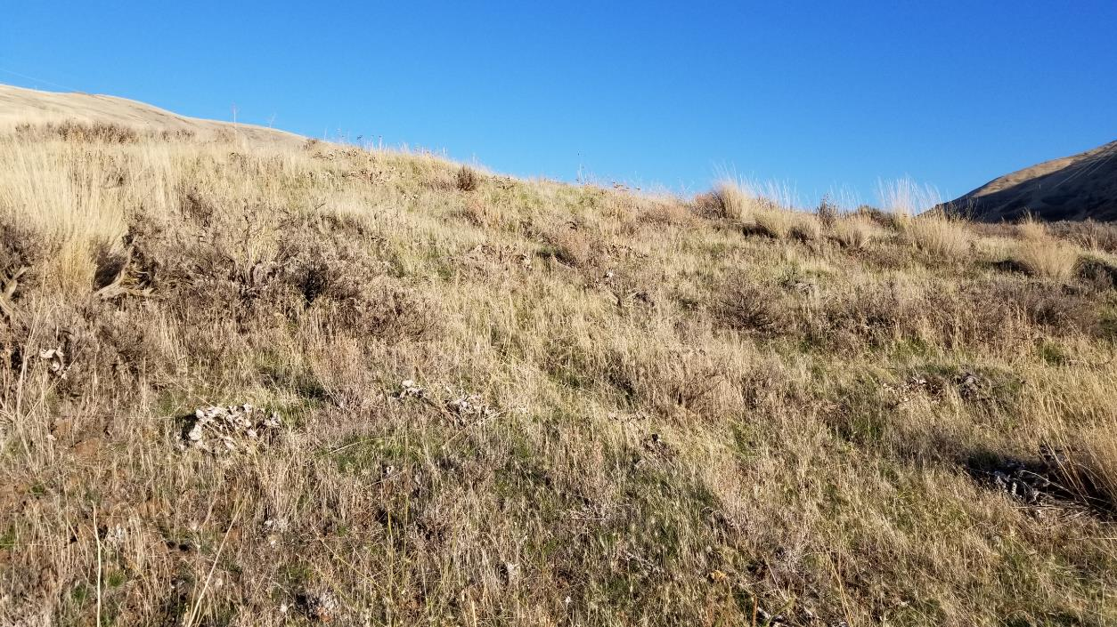
Part 3 –Site Description

Slide 2

Soil depth and Rockiness and Soil Texture
Soil
Click this Link for information on
- Soil Depth and Rockiness
- Soil Texture
https://casoilresource.lawr.ucdavis.edu/gmap/?loc=46.63772,-117.37747,z17

Slide 3
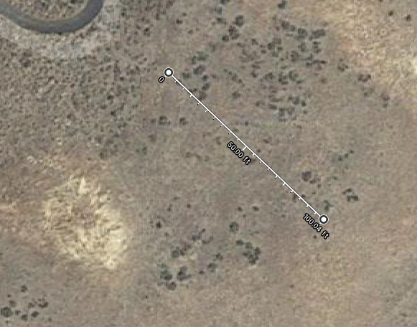
Slope
850 Feet Elevation
100-Foot Transect
838 Feet Elevation

Slide 4
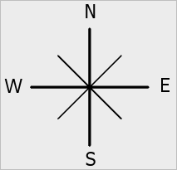
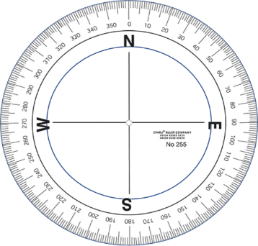
Aspect

