Slide 1


Biomass Production Estimation

Slide 2
Teacher Help Guide
Each biomass estimate site includes 2-3 slides.
  A slide with ecological site descriptions (precipitation level, soil type, etc.) and location information. If you would like more information about Ecological Site Descriptions (ESDs) go to: http://www.nrcs.usda.gov/wps/portal/nrcs/main/national/technical/ecoscience/desc/
  AND
  A slide with a close-in shot of a plot. In presention mode, this slide will first appear without the area’s biomass production. Have your students practice estimating production (lbs/acre) and/or discuss what the area’s production level is and why.
  AND/OR
  A slide with a general overview of the area. If there was not a close-in shot of the plot then this slide will first appear without the area’s biomass production in presentation mode.

Slide 3
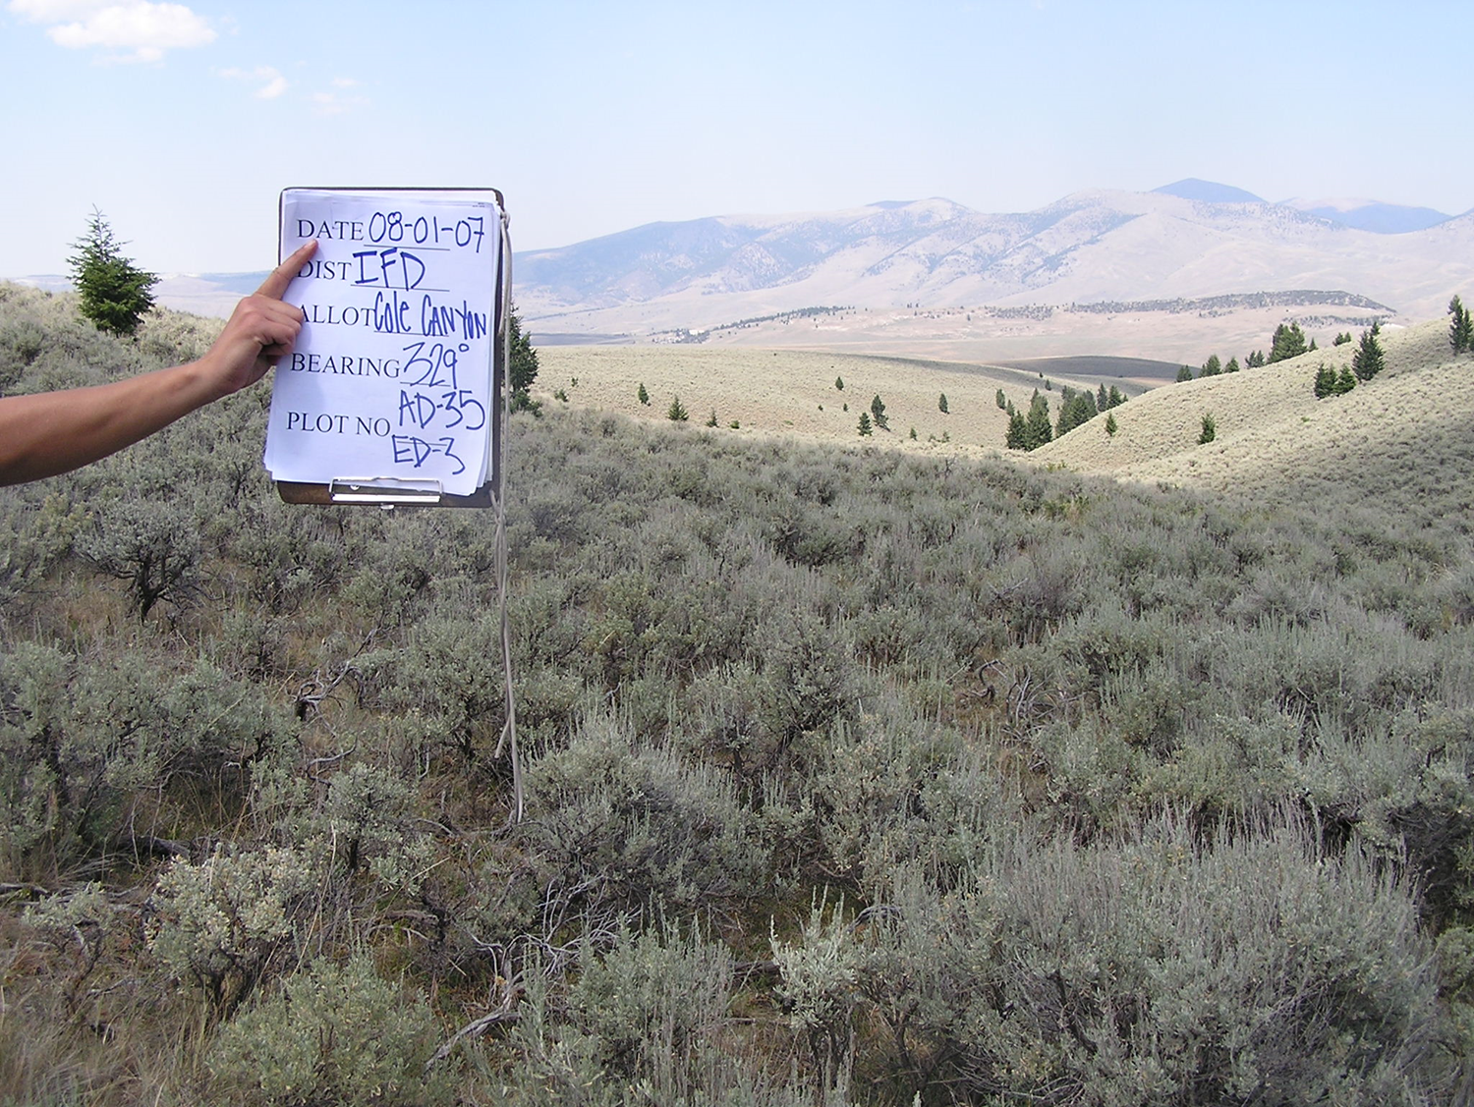
Practice – Estimate the Biomass

Slide 4
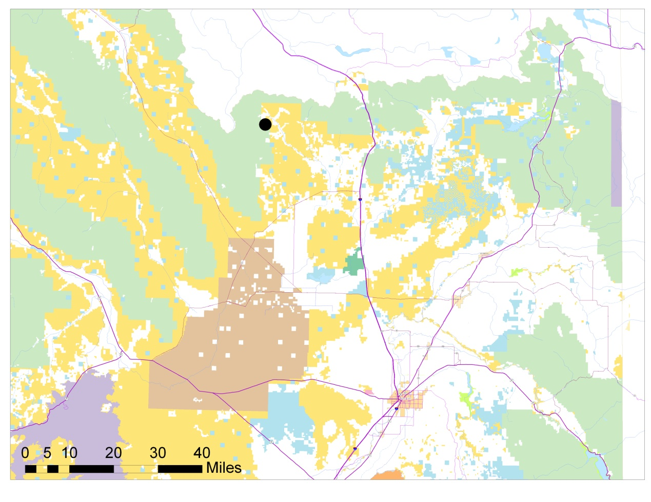
Loamy 16-22” precipitation ecological site.
Plant community is dominated by ARTRV/FEID (mountain big sagebrush and Idaho fescue).
Upper Medicine Lodge
area, 25 miles NW
of Dubois, ID.

Slide 5
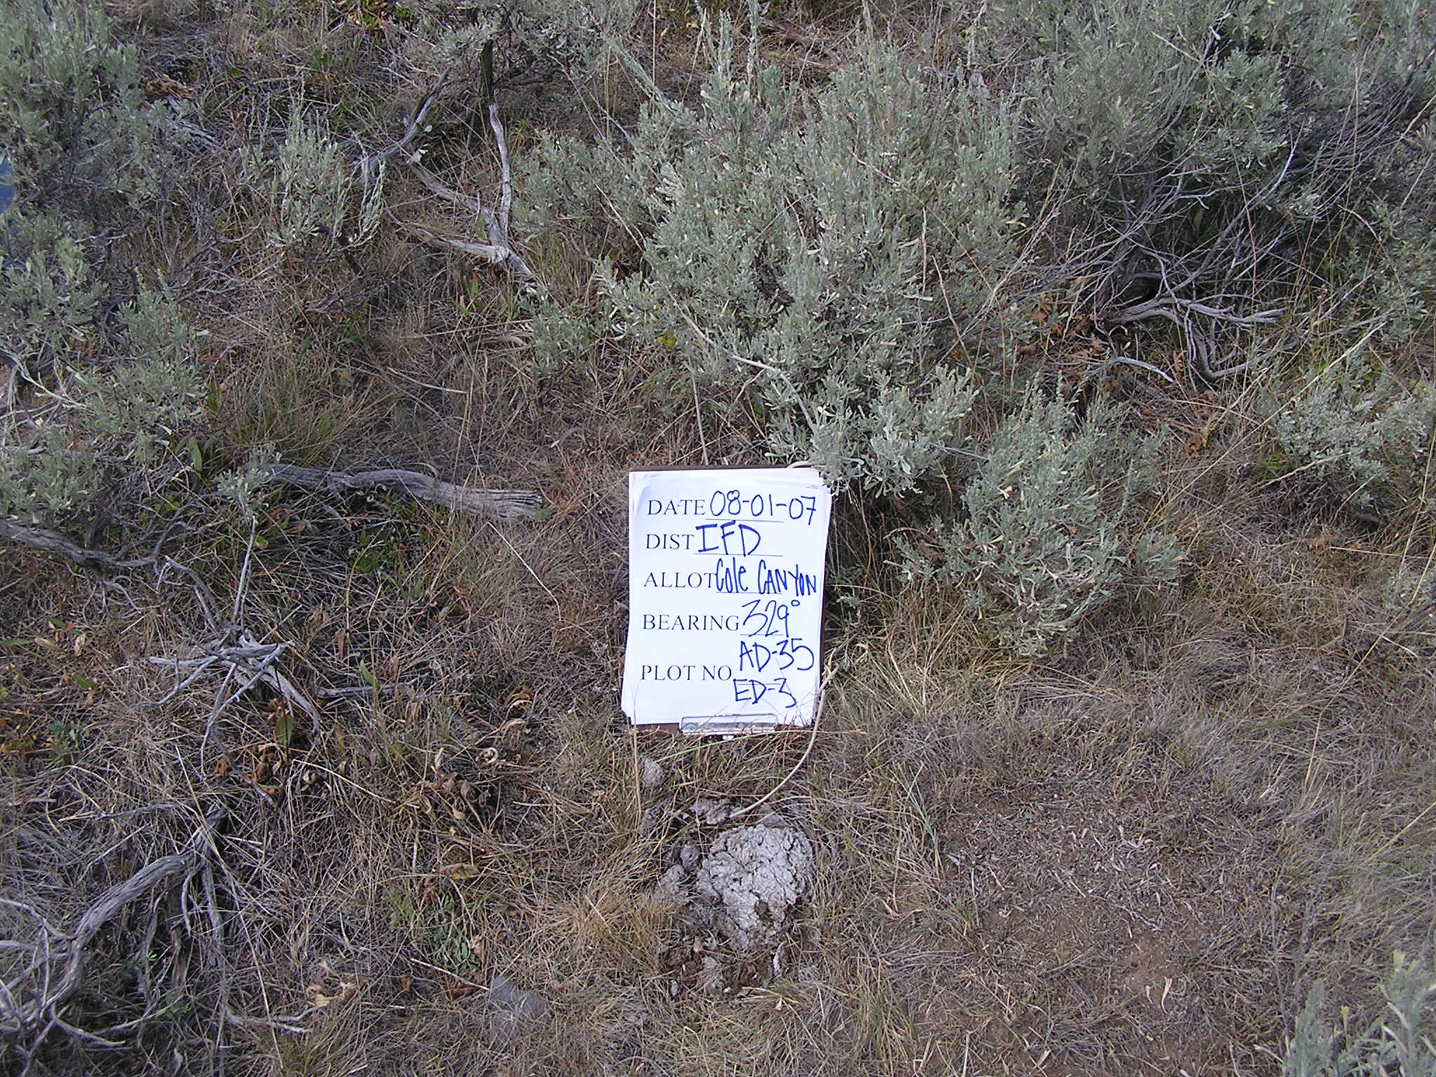
#1
640 lbs/acre

Slide 6
#1
640 lbs/acre

Slide 7
Windswept ridge 11-16” precipitation ecological site (shallow stony).
Plant community is dominated by ARFR/ARAR8/PHHO/Poa sp. (fringed sagebrush, low sagebrush, Hood’s phlox, and small bluegrasses).
Upper Medicine Lodge
area, 25 miles NW
of Dubois, ID.

Slide 8
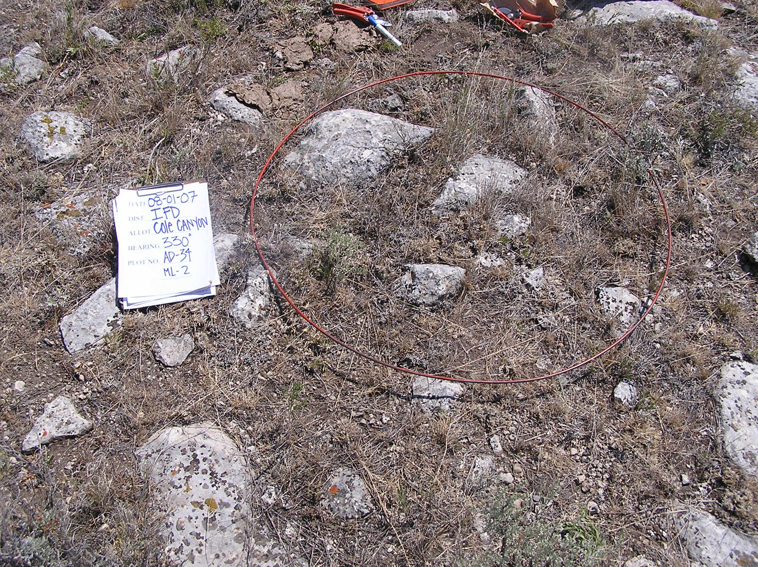
#2
196 lbs/acre.

Slide 9
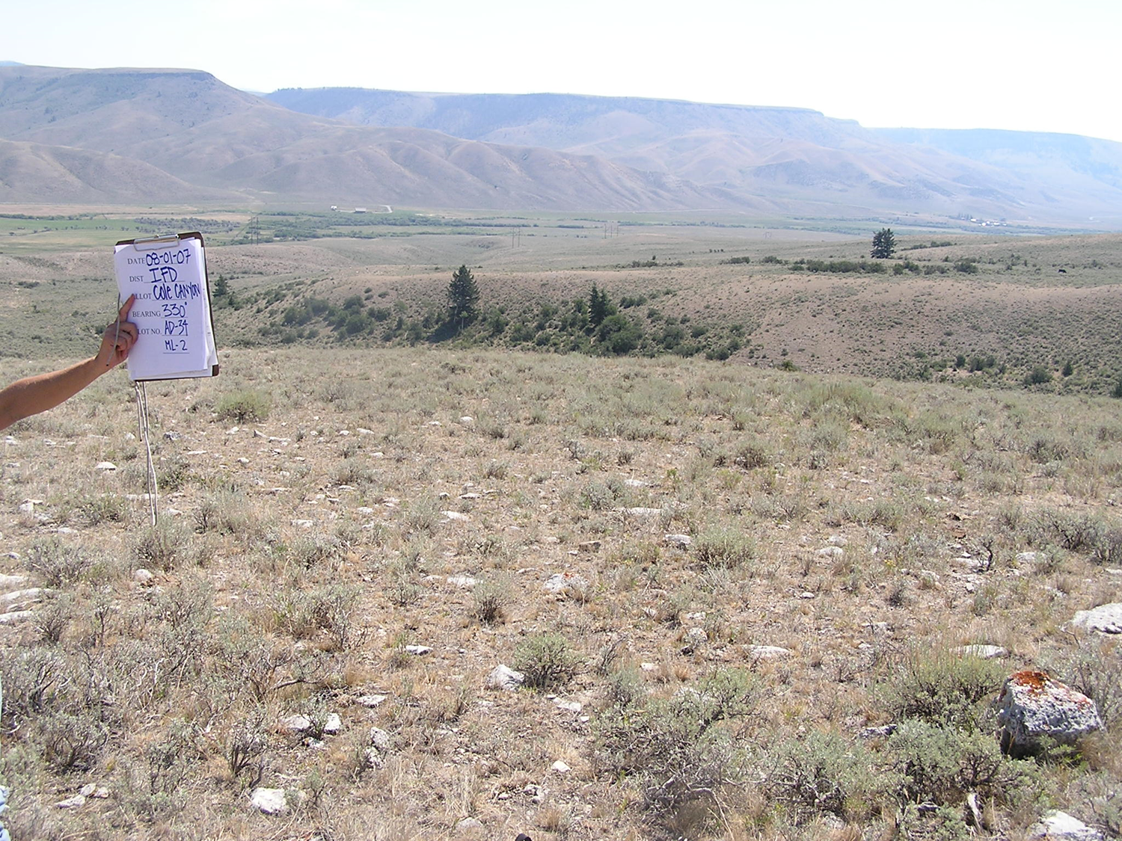
#2
196 lbs/acre.

Slide 10
Shallow gravelly loam 8-12” precipitation ecological site.
Plant community is dominated by ARAR8/PSSP6 (low sagebrush and bluebunch wheatgrass).
Upper Medicine Lodge
area, 25 miles NW
of Dubois, ID.

Slide 11
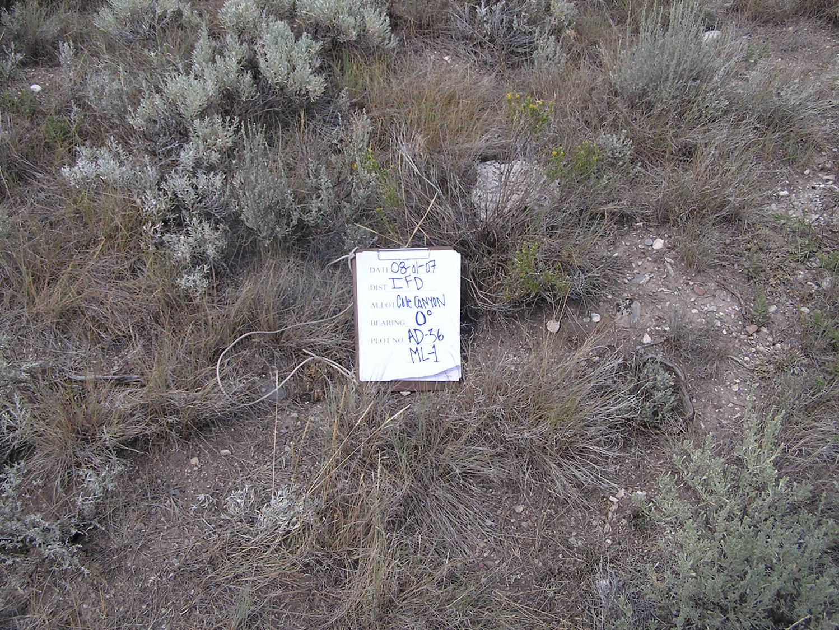
#3
420 lbs/acre.

Slide 12
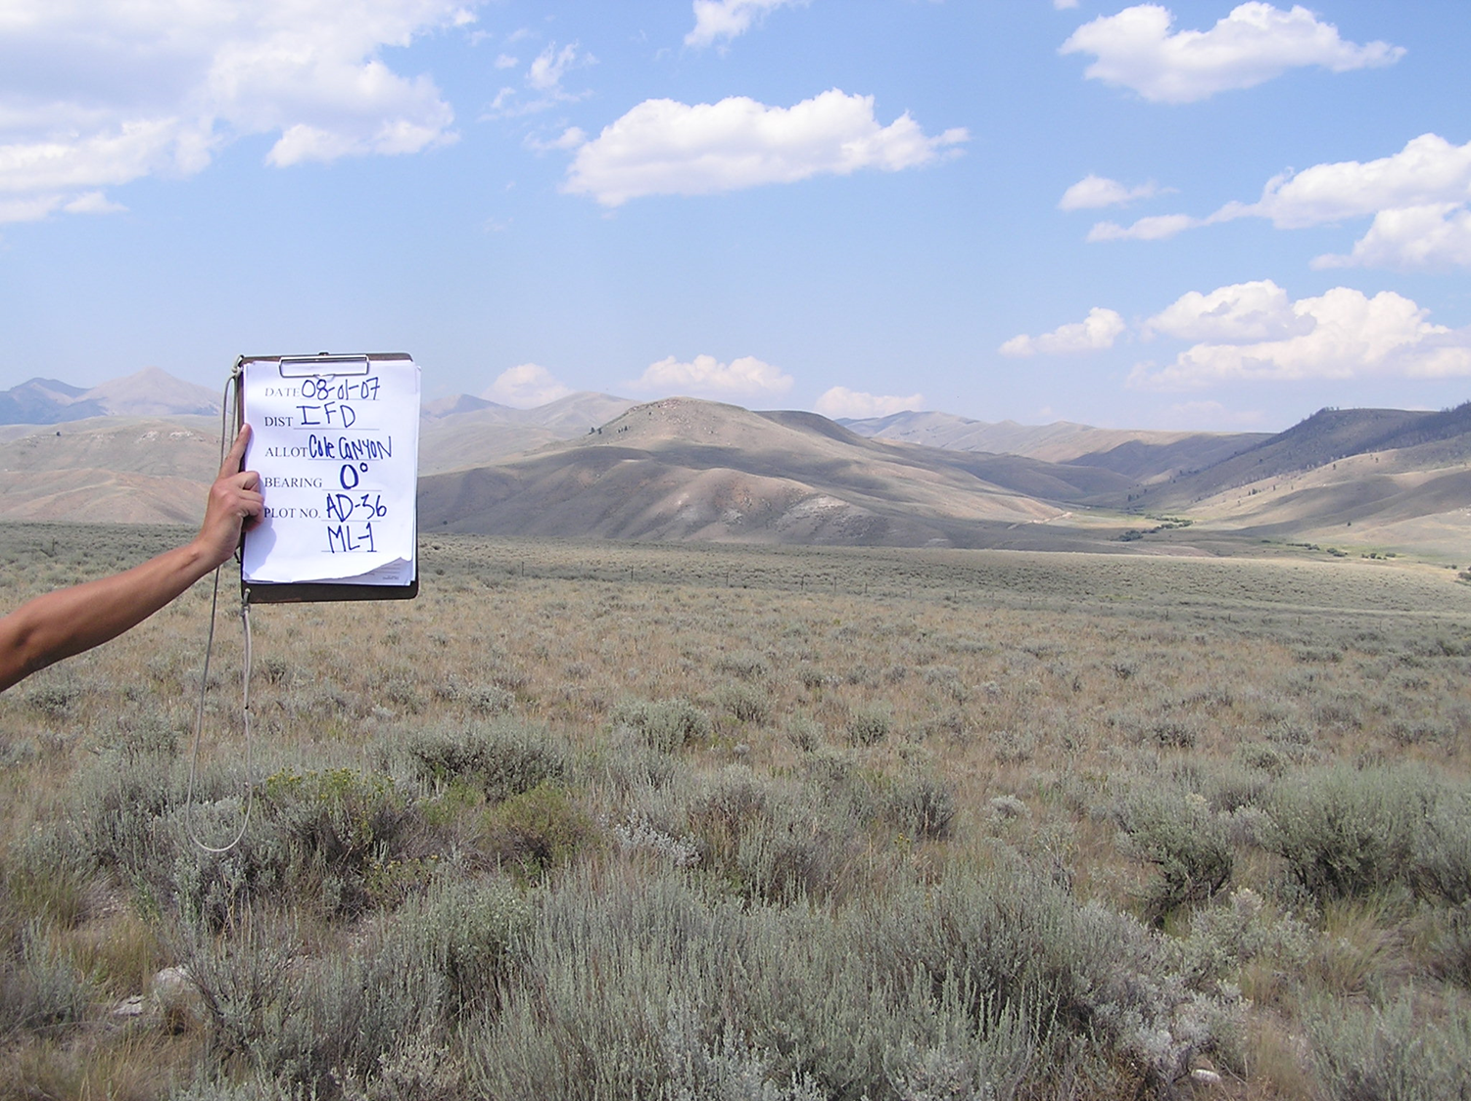
#3
420 lbs/acre.

Slide 13
Loamy 16-22” precipitation ecological site.
Plant community is dominated by ARTRV/FEID (mountain big sagebrush and Idaho fescue).
Upper Medicine Lodge
area, 25 miles NW of
Dubois, ID.

Slide 14
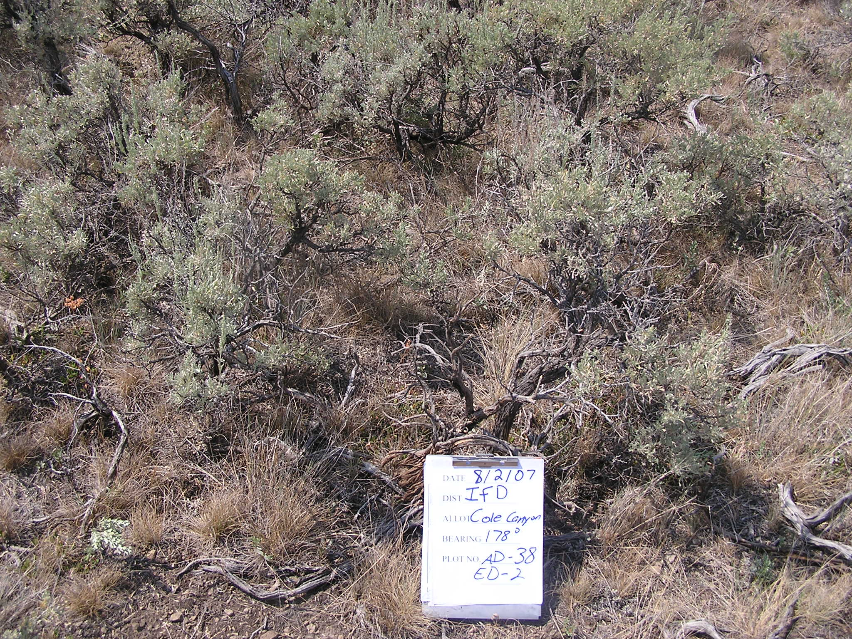
#4
700 lbs/acre.
Notes:
ED-2 is a B12-21 loamy 16-22” ecological site dominated by ARTRV/FEID
Production estimated at 700 lbs/acre
Upper Medicine Lodge area

Slide 15
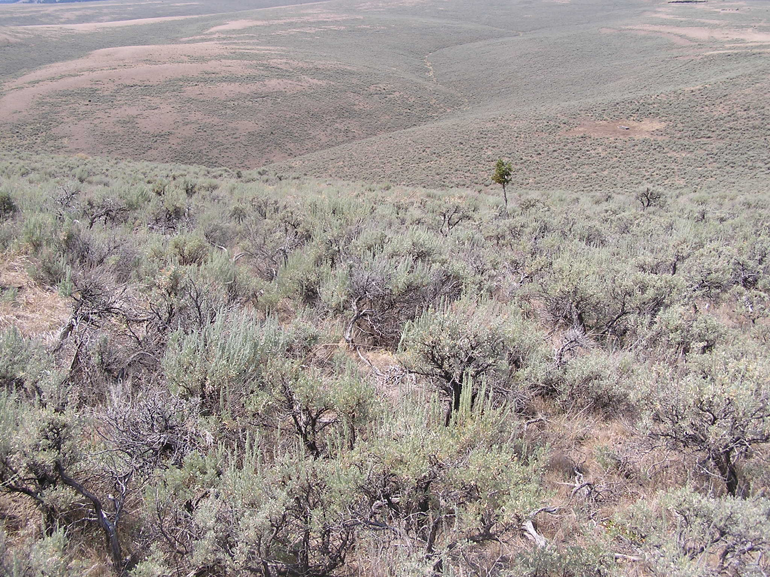
#4
700 lbs/acre.

Slide 16
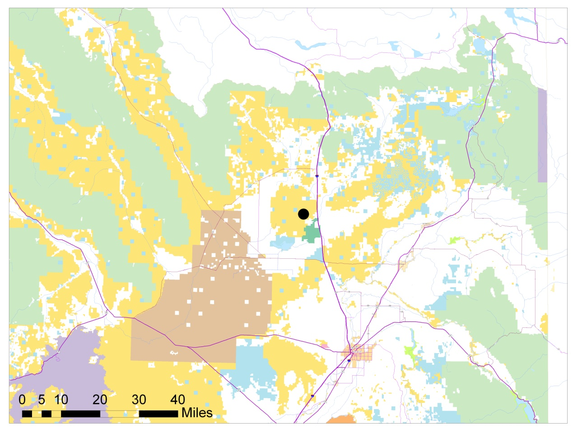
Loamy 7-10” precipitation ecological site that burned in 2001.
Plant community is dominated by ARTRW/STCO-ORHY(Wyoming big sagebrush, needle-and-thread, and Indian ricegrass).
Table Butte area,
12 miles NW of Hamer, ID.

Slide 17
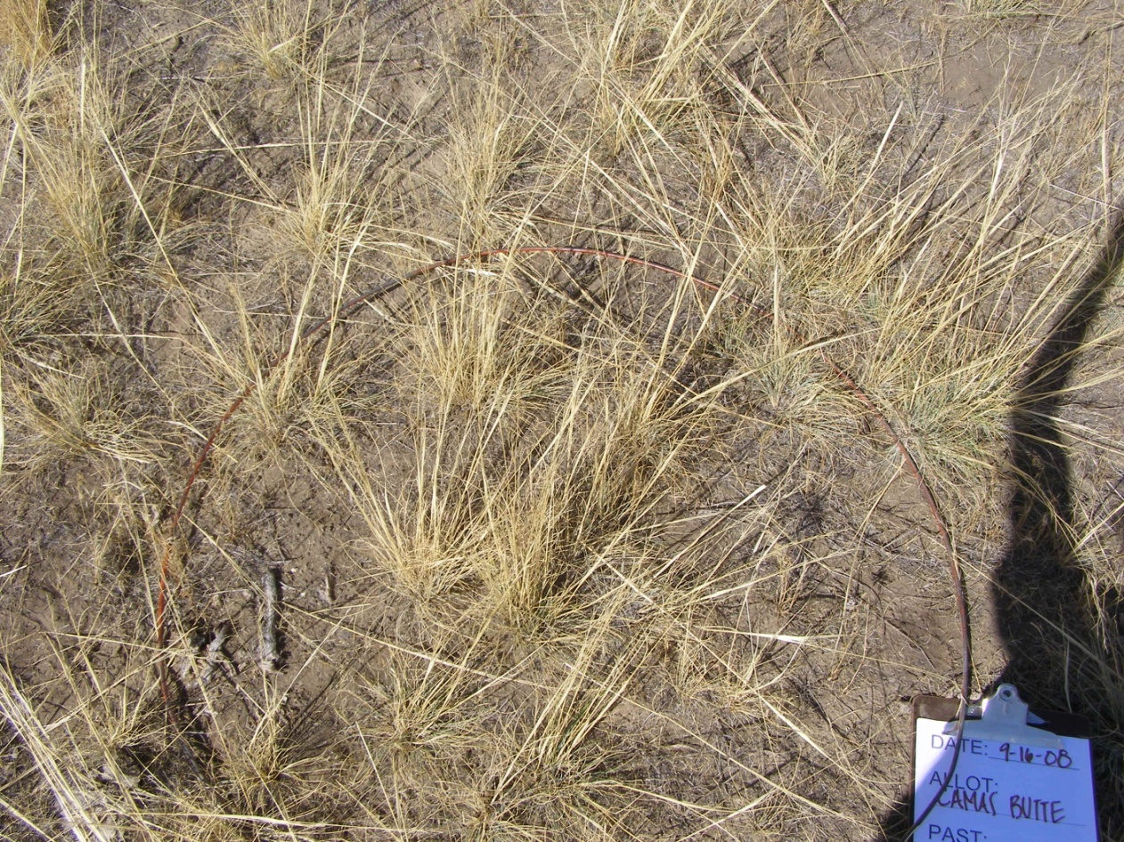
#5
418 lbs/acre
Notes:
VM732 is a B11b-19 loamy 7-10” ecological site dominated by ARTRW/STCO-ORHY
This site burned in 2001.
Production estimated at 418 lbs/acre
North of Mud Lake, west of Hamer

Slide 18
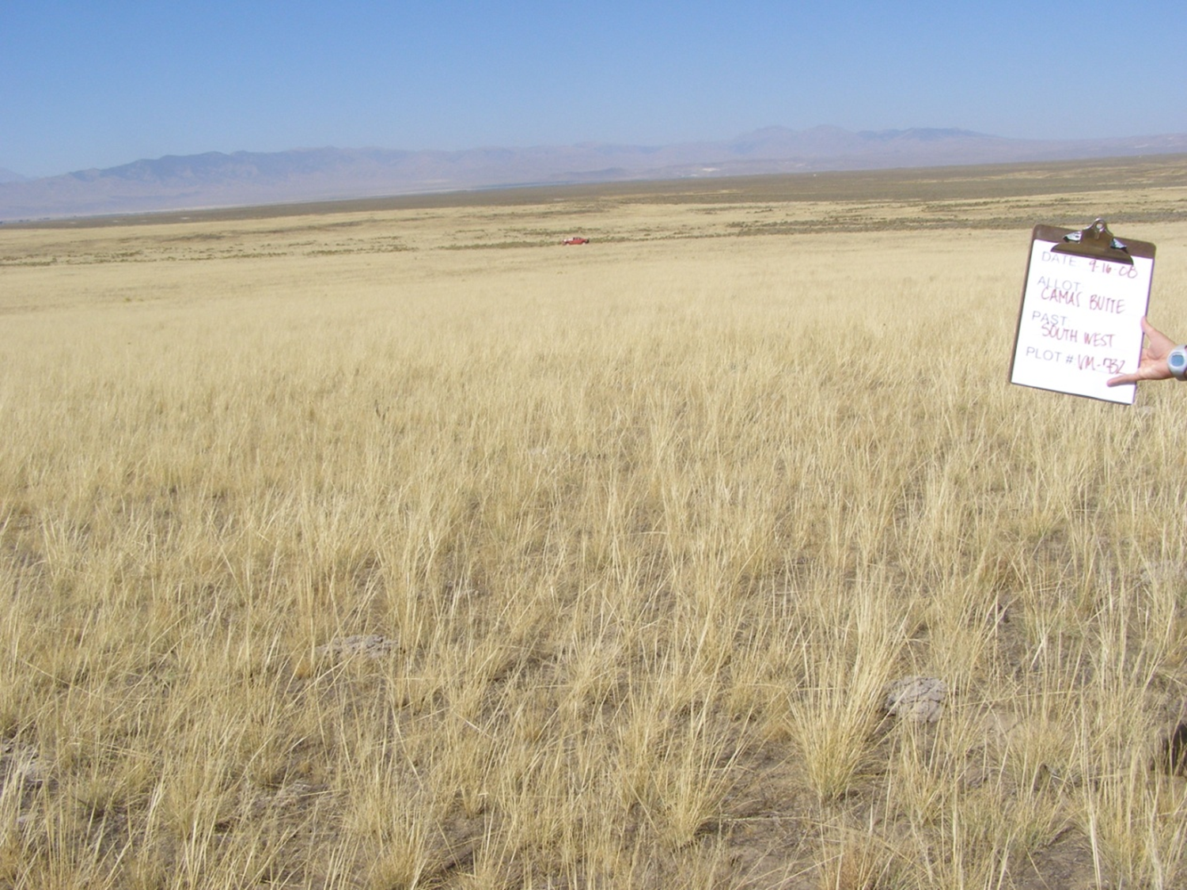
#5
418 lbs/acre

Slide 19
Sandy 8-12” precipitation ecological site.
Plant community is dominated by ARTRT/STCO-ORHY (basin big sagebrush, needle-and-thread, and Indian ricegrass).
Table Butte area,
12 miles NW of Hamer, ID.

Slide 20
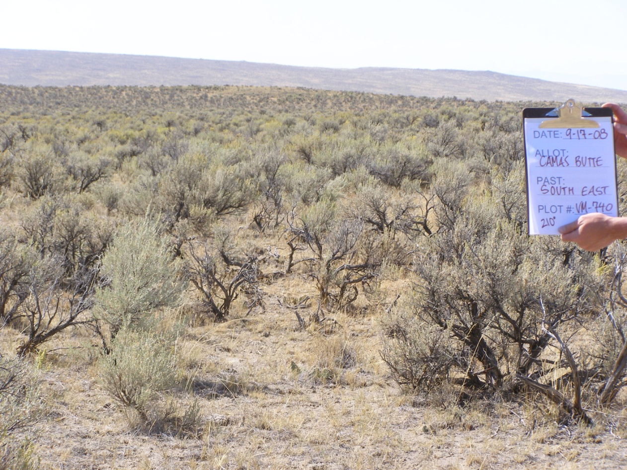
#6
251 lbs/acre

Slide 21
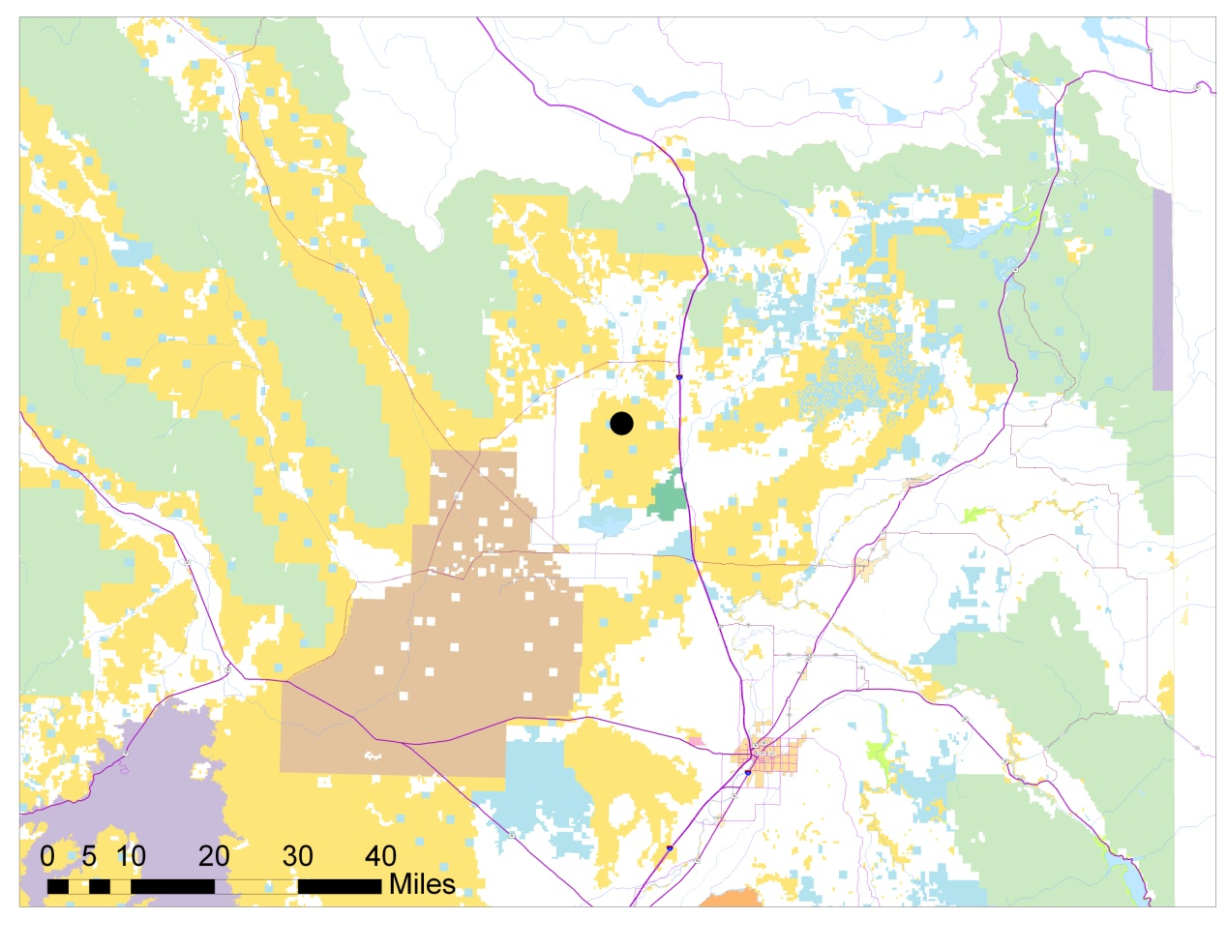
Loamy 7-10” precipitation ecological site.
Plant community is dominated by ARTRW/STCO-ORHY (Wyoming big sagebrush, needle-and-thread, and Indian ricegrass).
Table Butte area,
15 miles NW of
Hamer, ID.

Slide 22
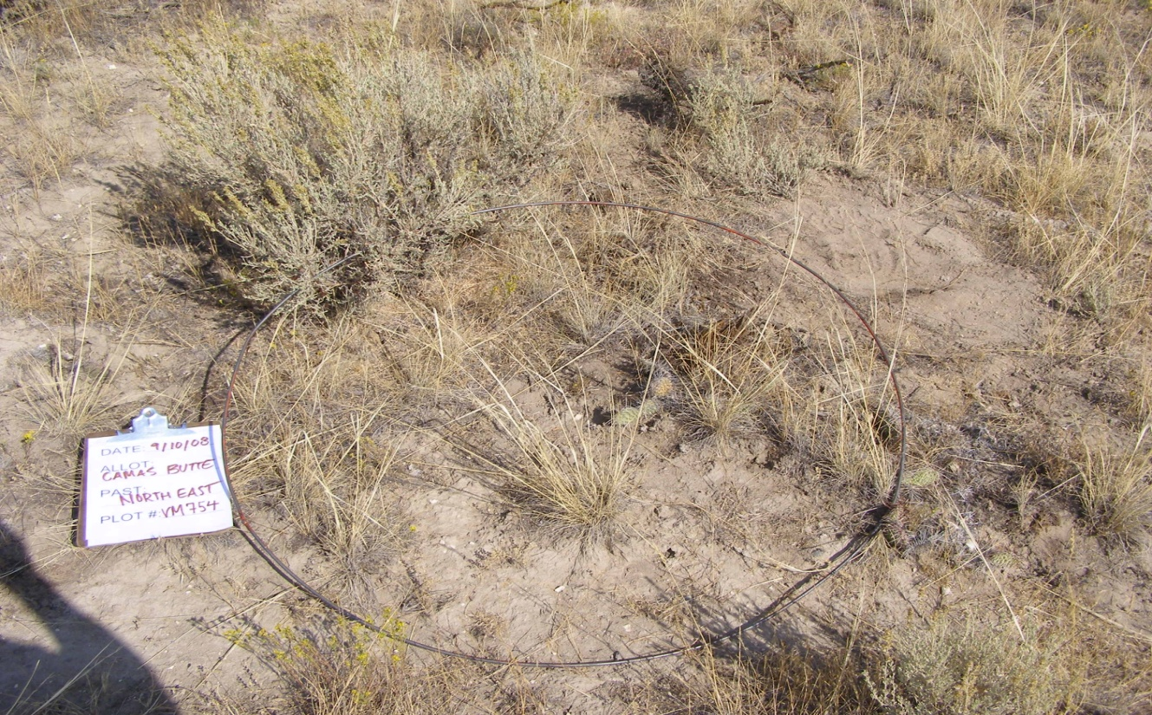
#7
262 lbs/acre
Notes:
VM-754 is a B11b-19 loamy 7-10” ecological site dominated by ARTRW/STCO-ORHY
Production estimated at 262 lbs/acre
North of Mud Lake

Slide 23
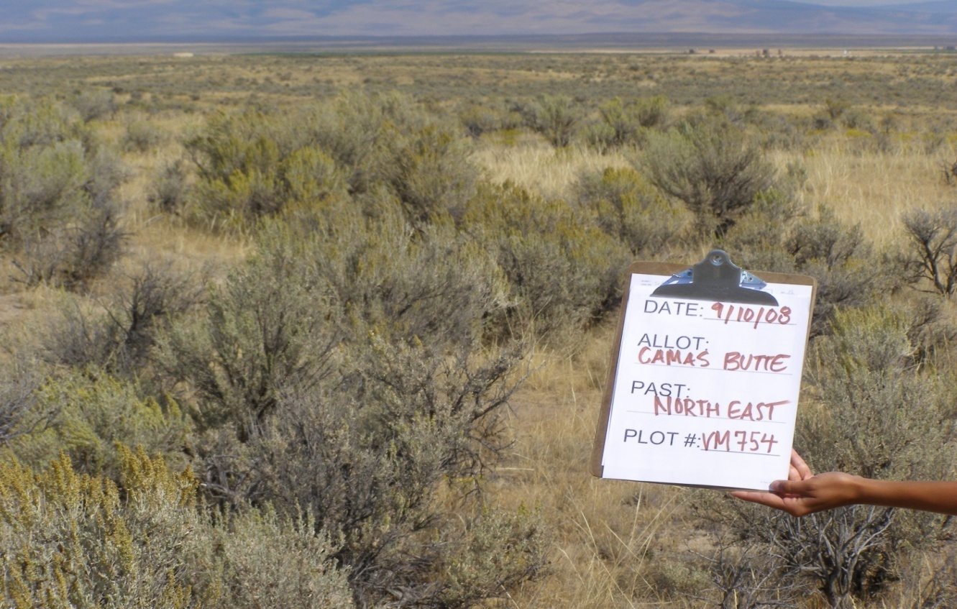
#7
262 lbs/acre

Slide 24

Loamy 7-10” precipitation ecological site.
Plant community is dominated by ARTRW/STCO-ORHY (Wyoming big sagebrush, needle-and-thread, and Indian ricegrass), but has relatively high annual component (desert alyssum and cheatgrass).
Table Butte area,
15 miles NW of
Hamer, ID (north of
Mud Lake).

Slide 25
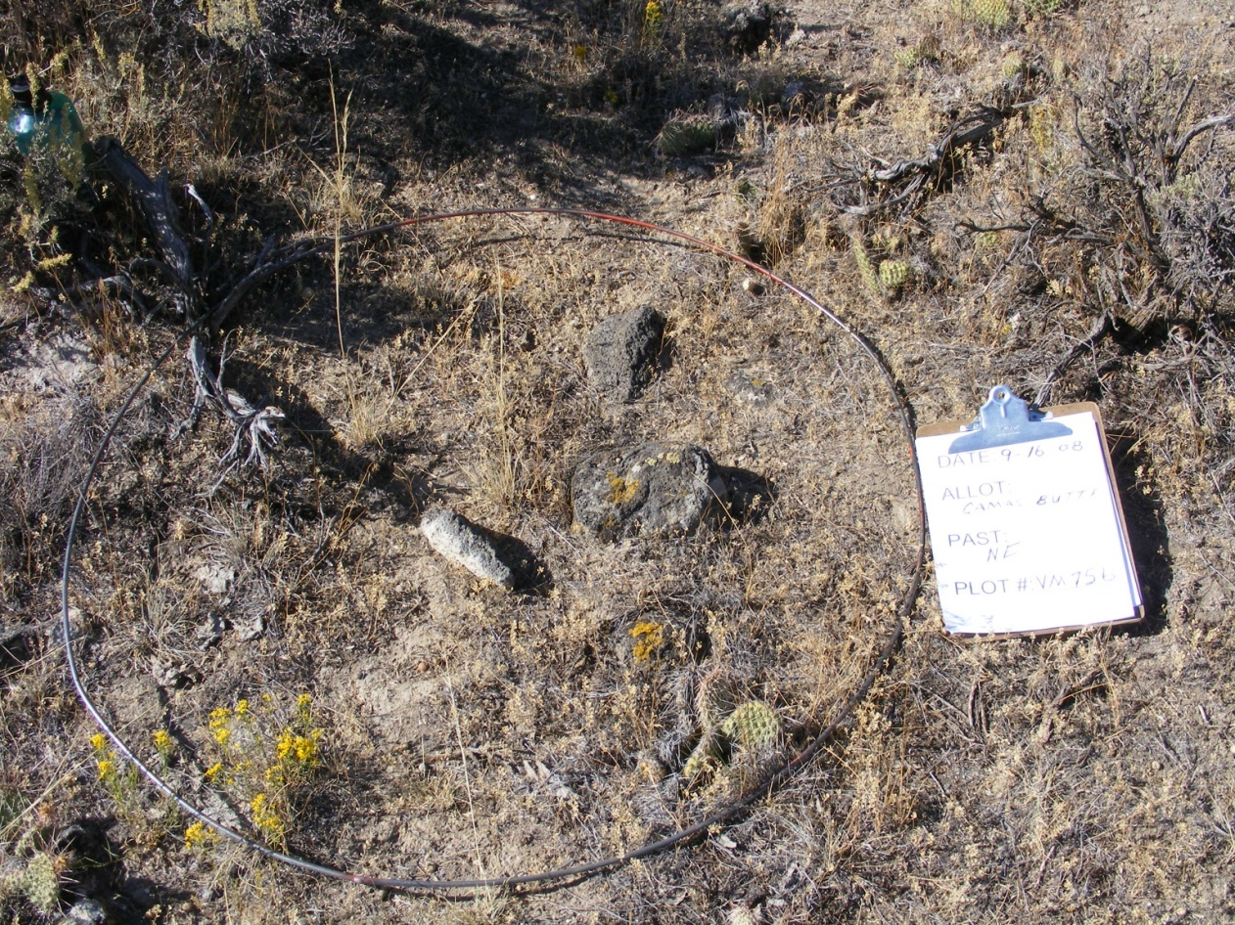
#8
143 lbs/acre
Notes:
VM756 is a B11b-19 site, but has a relatively high annual component (desert alyssum and cheatgrass)
North of Mud Lake
Production estimated at 143 lbs/acre

Slide 26
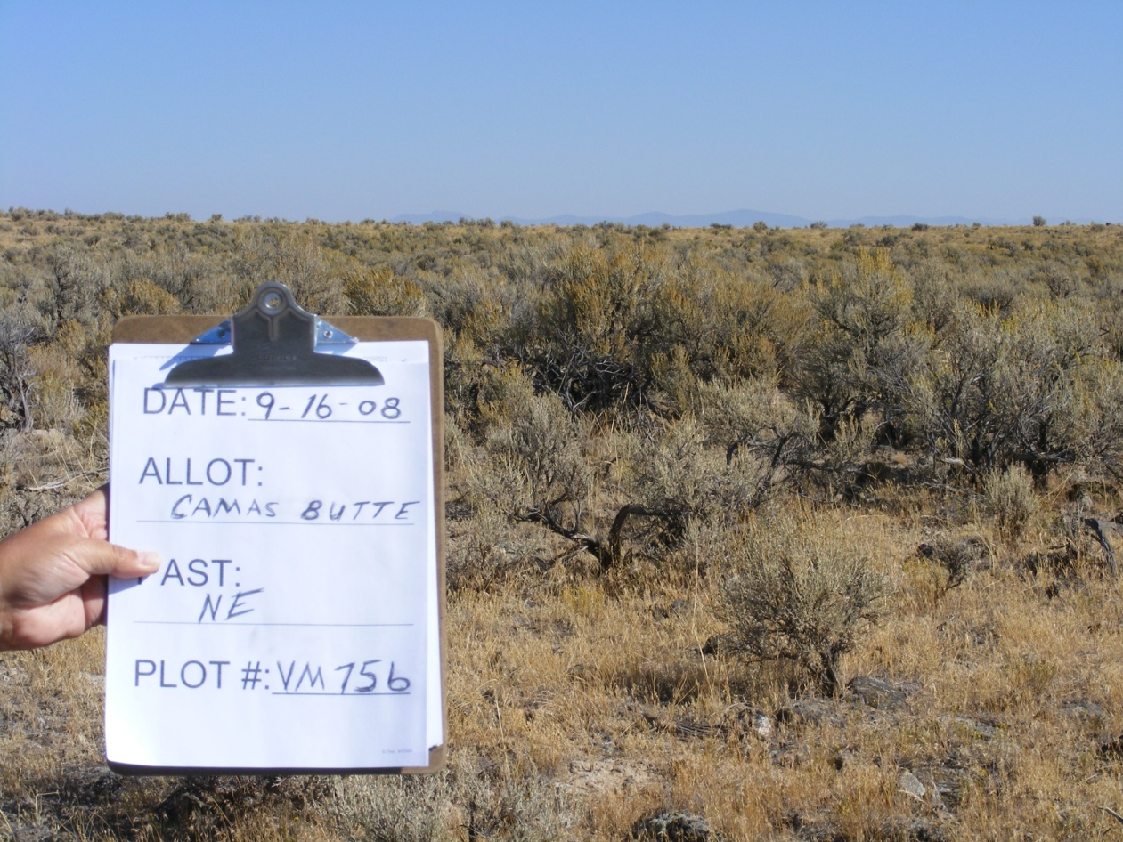
#8
143 lbs/acre

Slide 27

Loamy 16-22” precipitation ecological site.
Plant community is dominated by ARTRV/FEID (mountain big sagebrush and Idaho fescue).
Medicine Lodge area,
25 miles NW of
Dubois, ID.

Slide 28
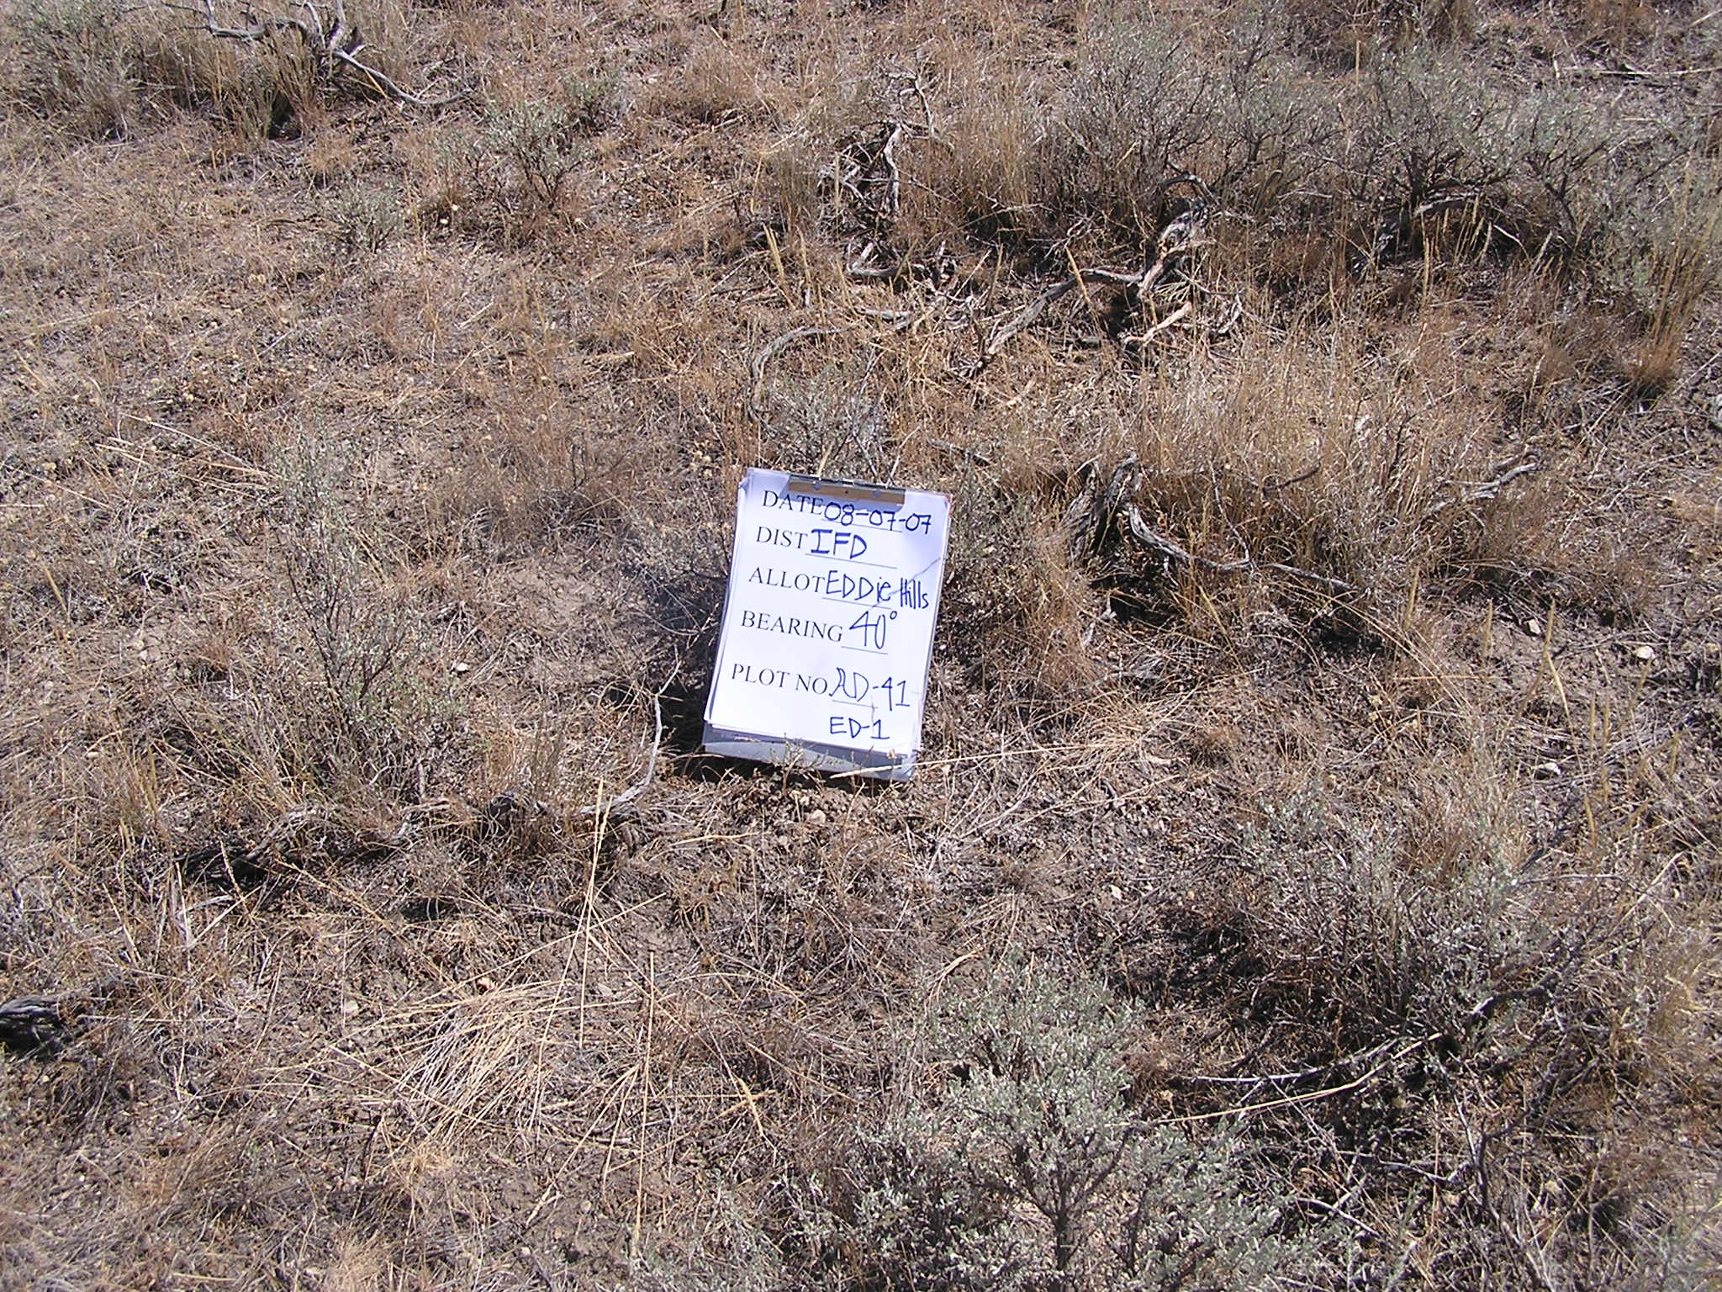
#9
540 lbs/acre
Notes:
B12-21 Loamy 16-22” ecological site dominated by ARTRV/FEID/
Production estimated at 540 lbs/acre
Medicine Lodge area

Slide 29
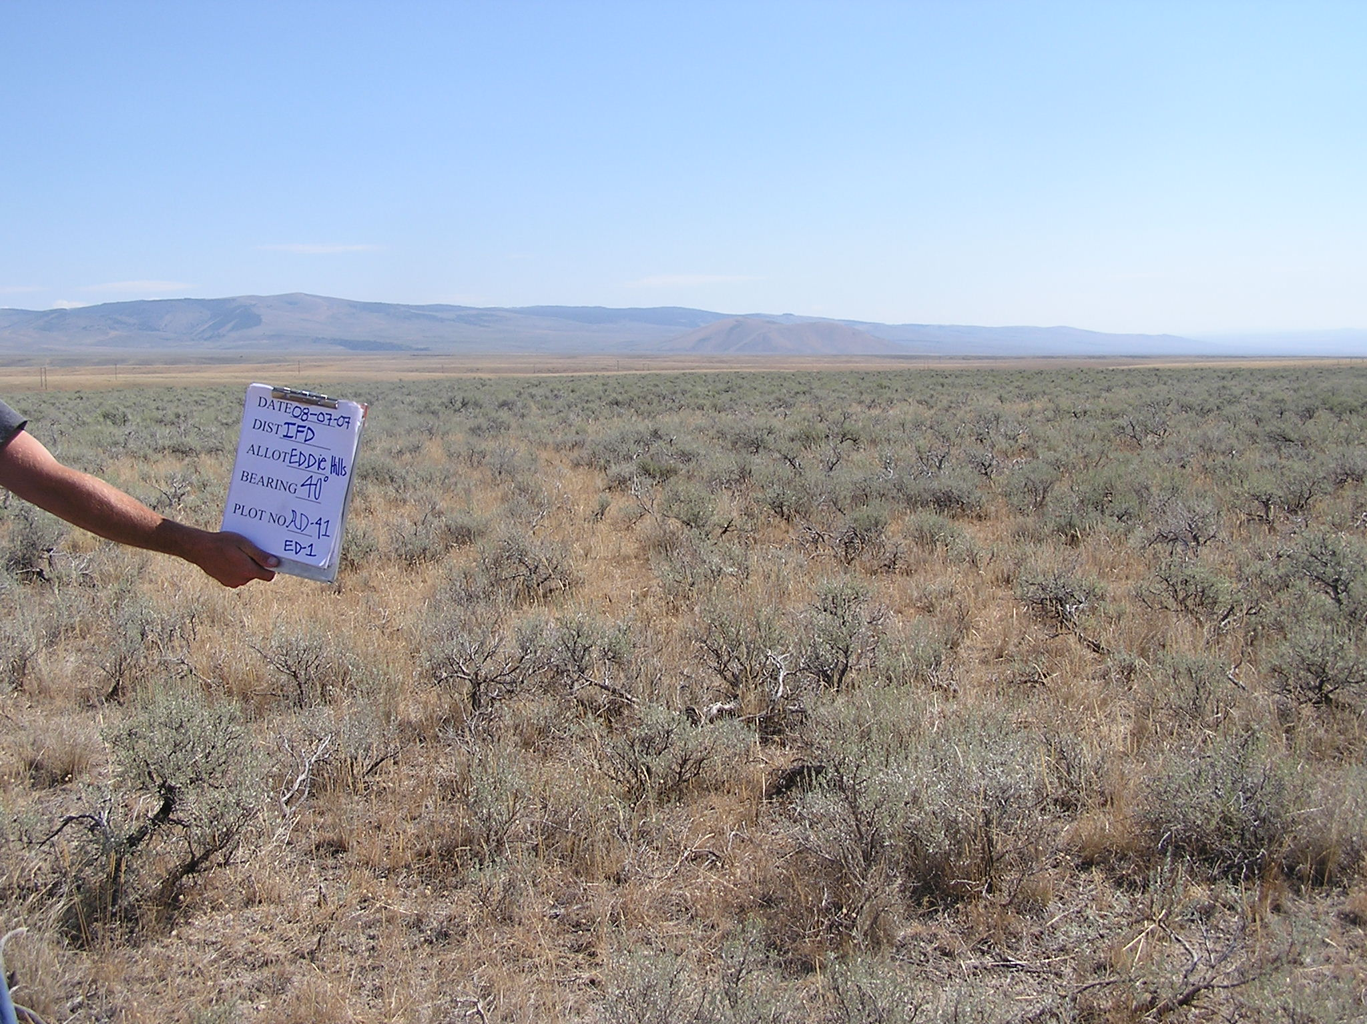
#9
540 lbs/acre

Slide 30
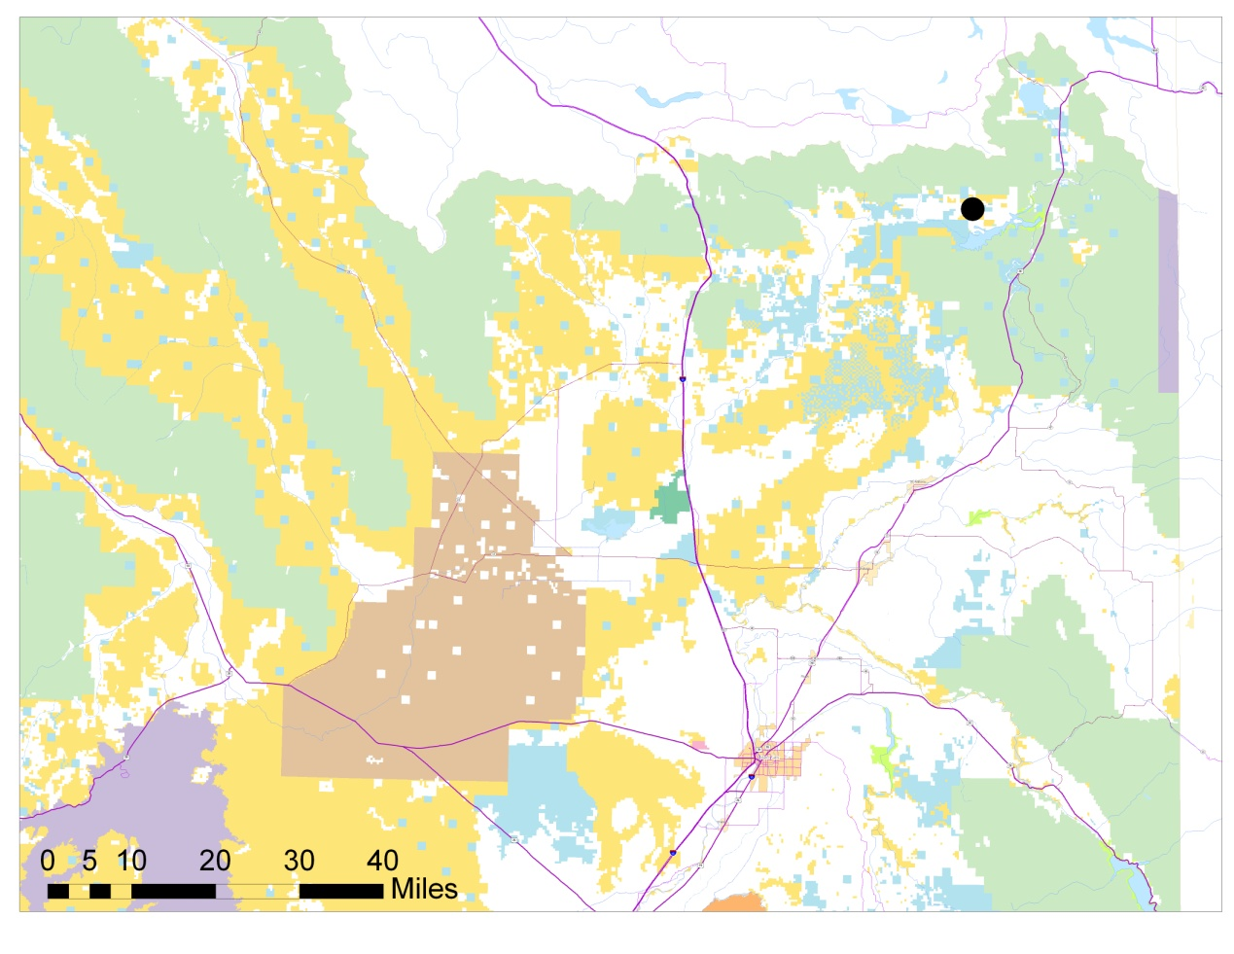
Loamy 22+” precipitation ecological site.
Plant community is dominated by ARTRV/BRCA/FEID (mountain big sagebrush, mountain brome, and Idaho fescue).
Shotgun Valley, 10
miles west of Island
Park Reservoir.

Slide 31
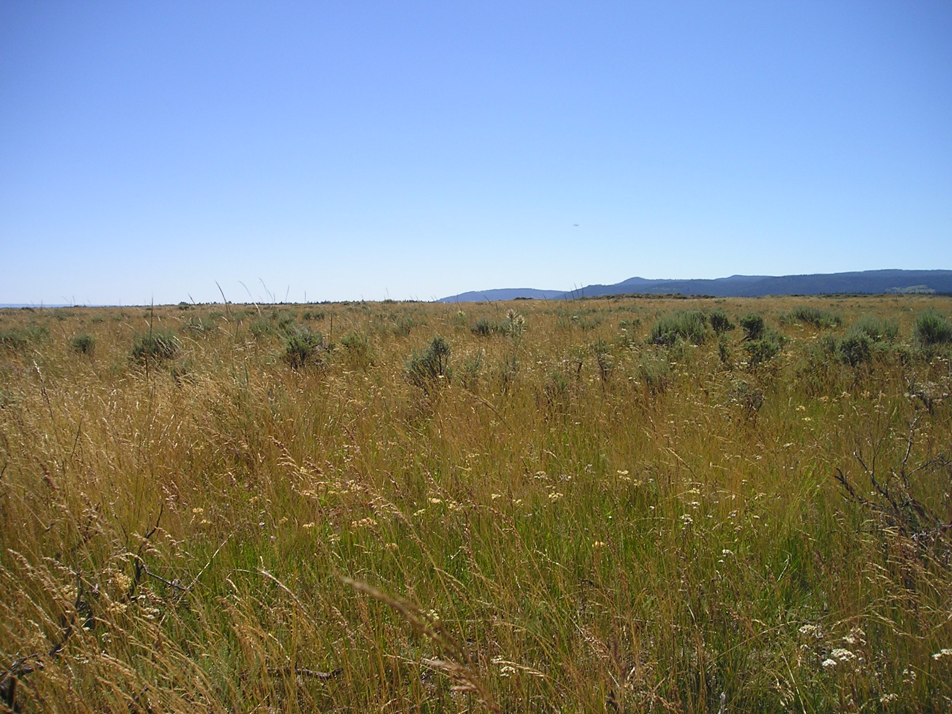
#10
2600 lbs/acre
Notes:
B13-24, loamy 22+” ARTRV/BRCA/FEID ecological site, Shotgun Valley
Estimated production is 2600 lbs/acre

Slide 32

Loamy 16-22” precipitation ecological site.
Plant community is dominated by ARTRV/FEID (mountain big sagebrush and Idaho fescue), but this photo shows PHPR3 (timothy) as the dominant grass.
Shotgun Valley, 5
miles north of Island
Park Reservoir.

Slide 33
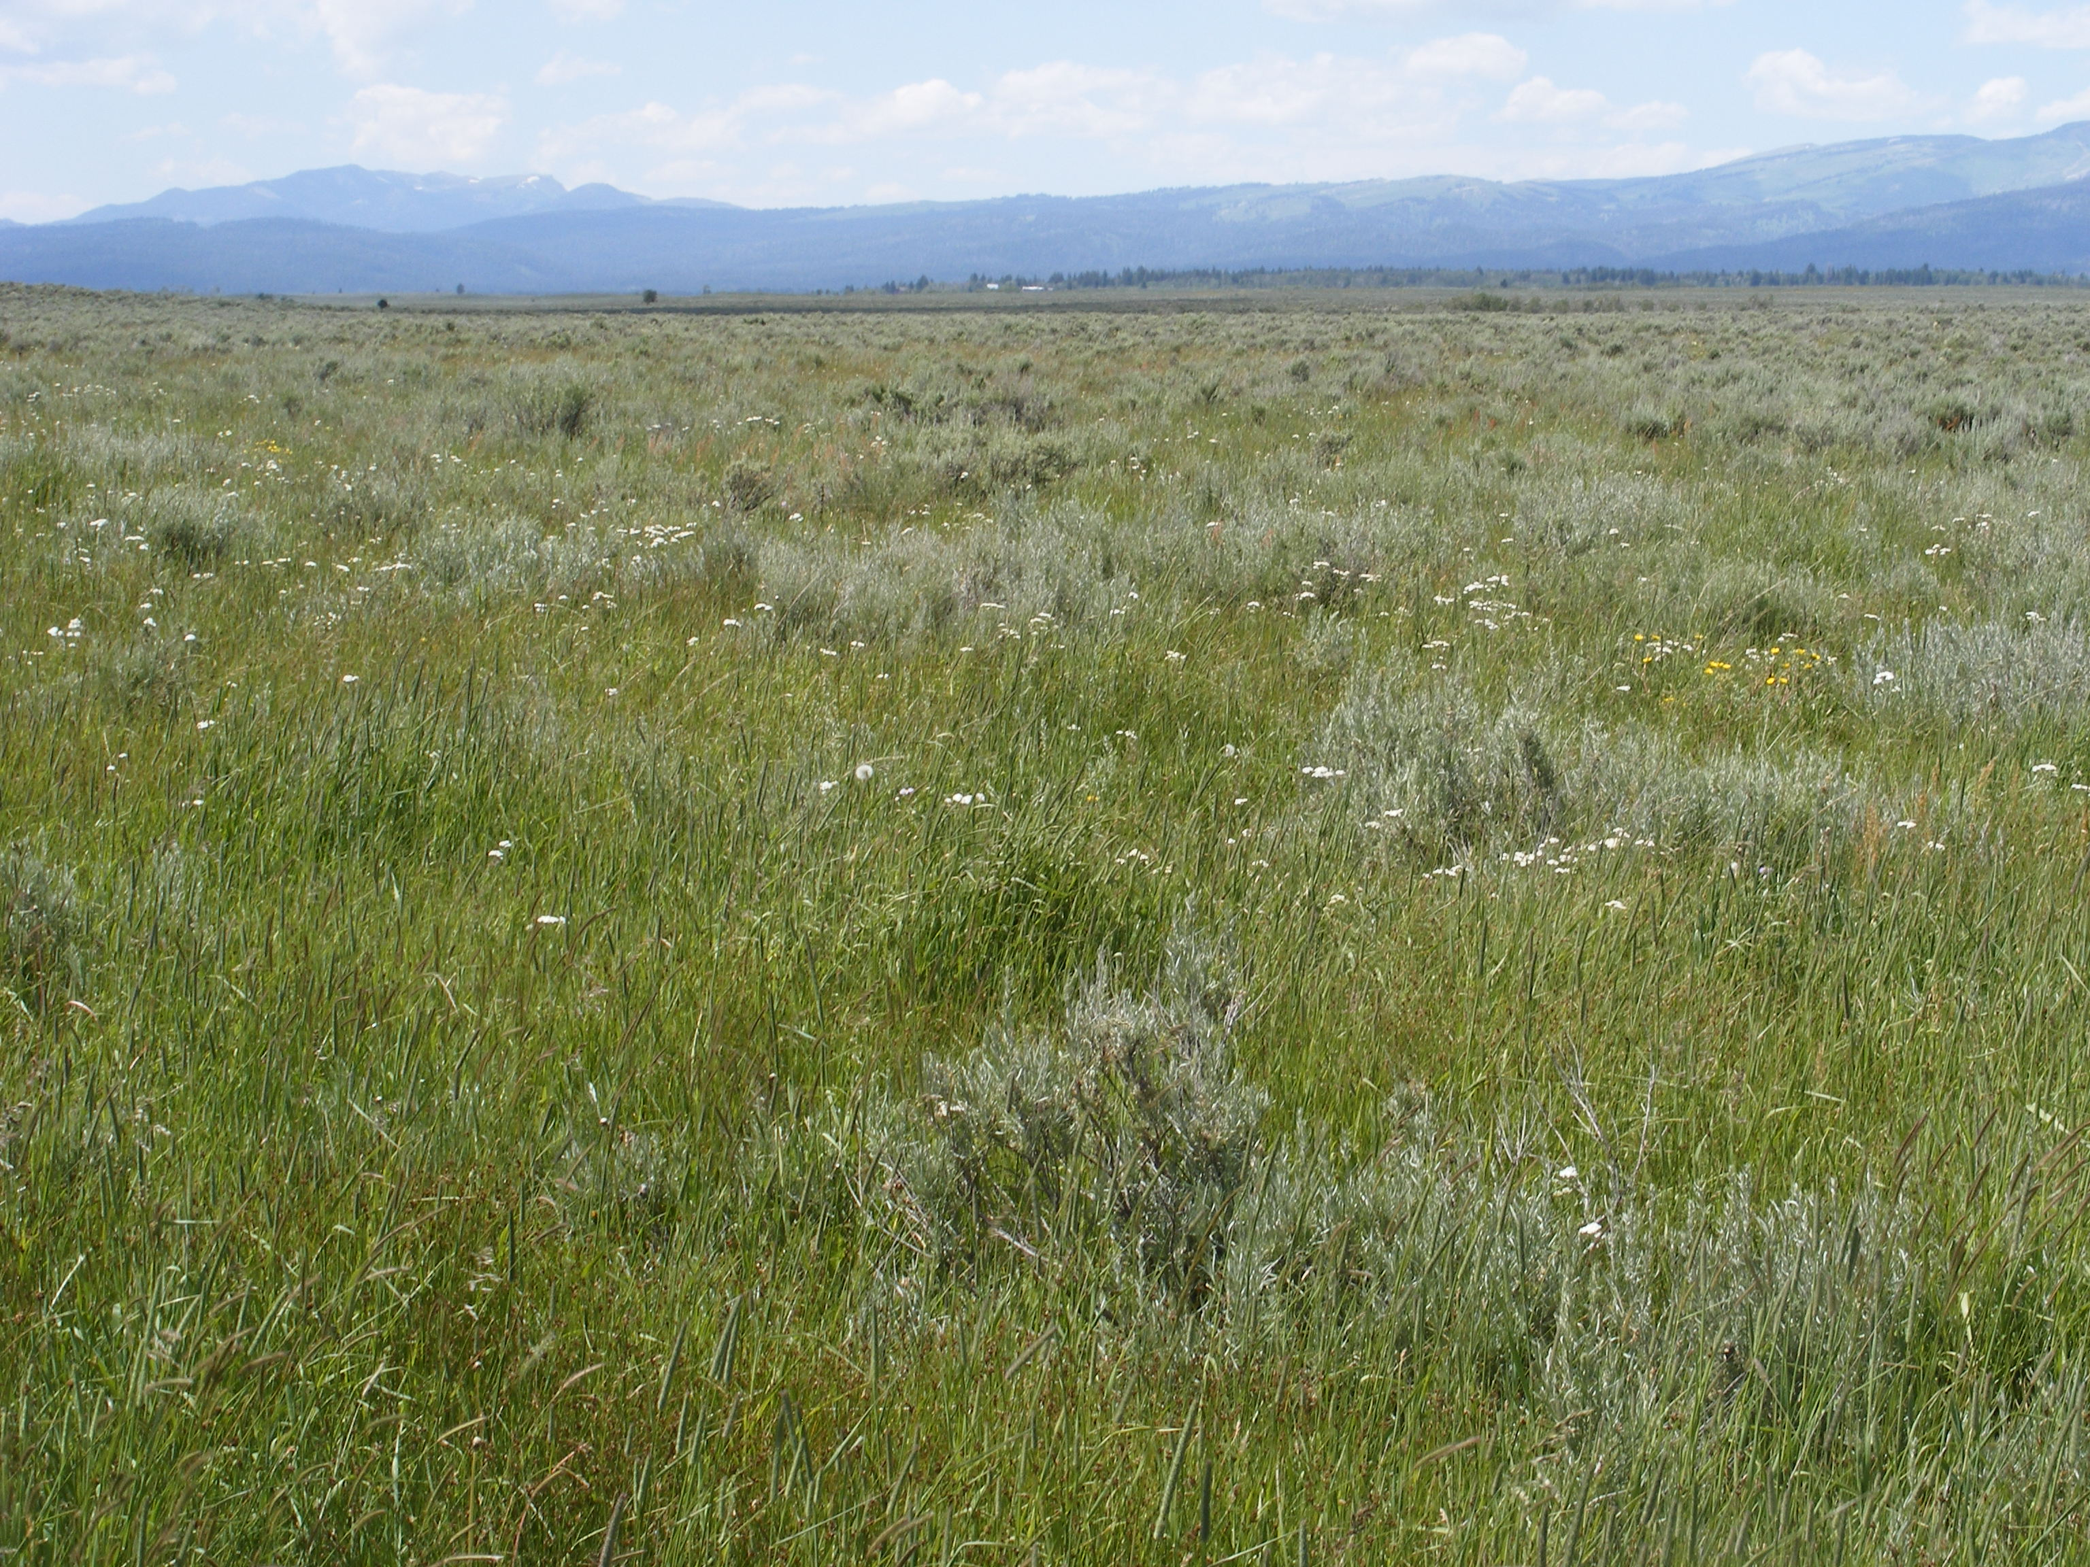
#11
2,000 – 2,500 lbs/acre.

Slide 34

Loamy 12-16” precipitation ecological site that burned in 2003.
Plant community is dominated by ARTRV/PSSP6 (mountain big sagebrush and bluebunch wheatgrass).
Medicine Lodge
area, 15 miles NW
of Dubois, ID.

Slide 35
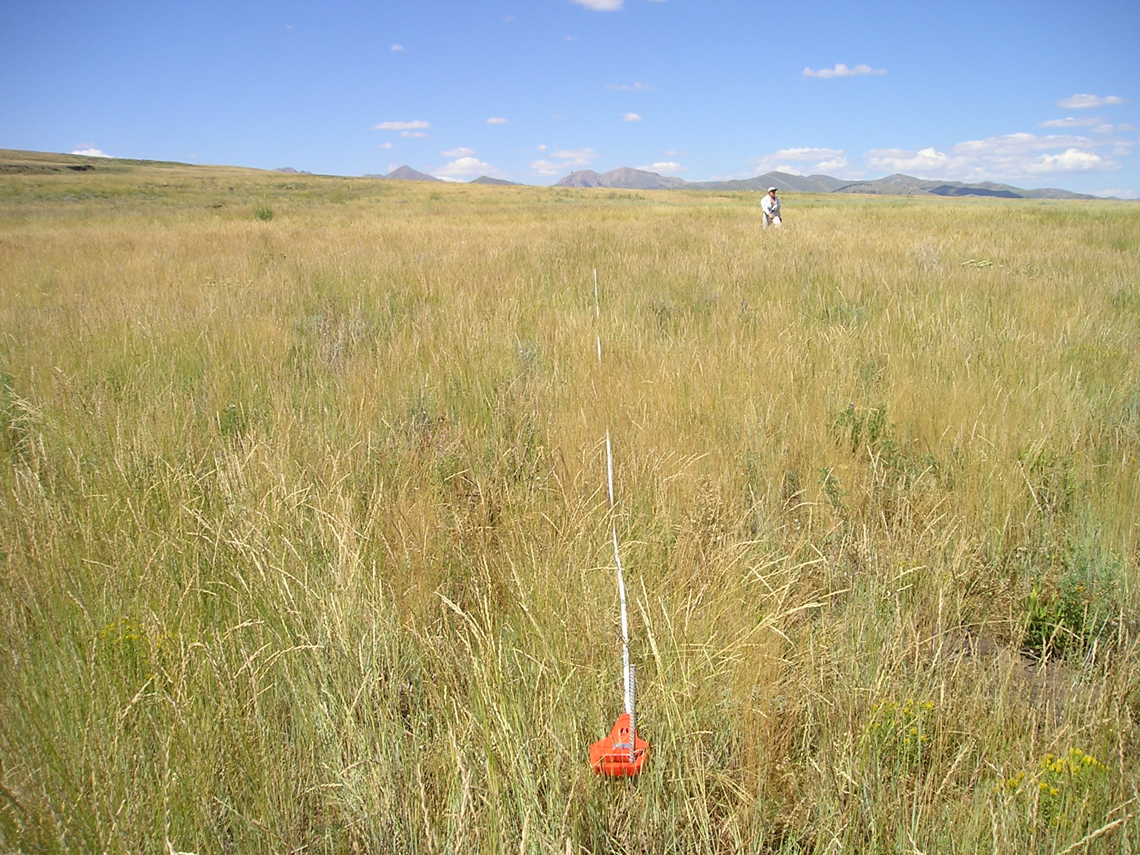
#12
1200 lbs/acre

Slide 36

Loamy 16-22” precipitation ecological site that burned in 2003.
Plant community is dominated by ARTRV/FEID (mountain big sagebrush and Idaho fescue).
Medicine Lodge
area, 20 miles NW
of Dubois, ID.

Slide 37
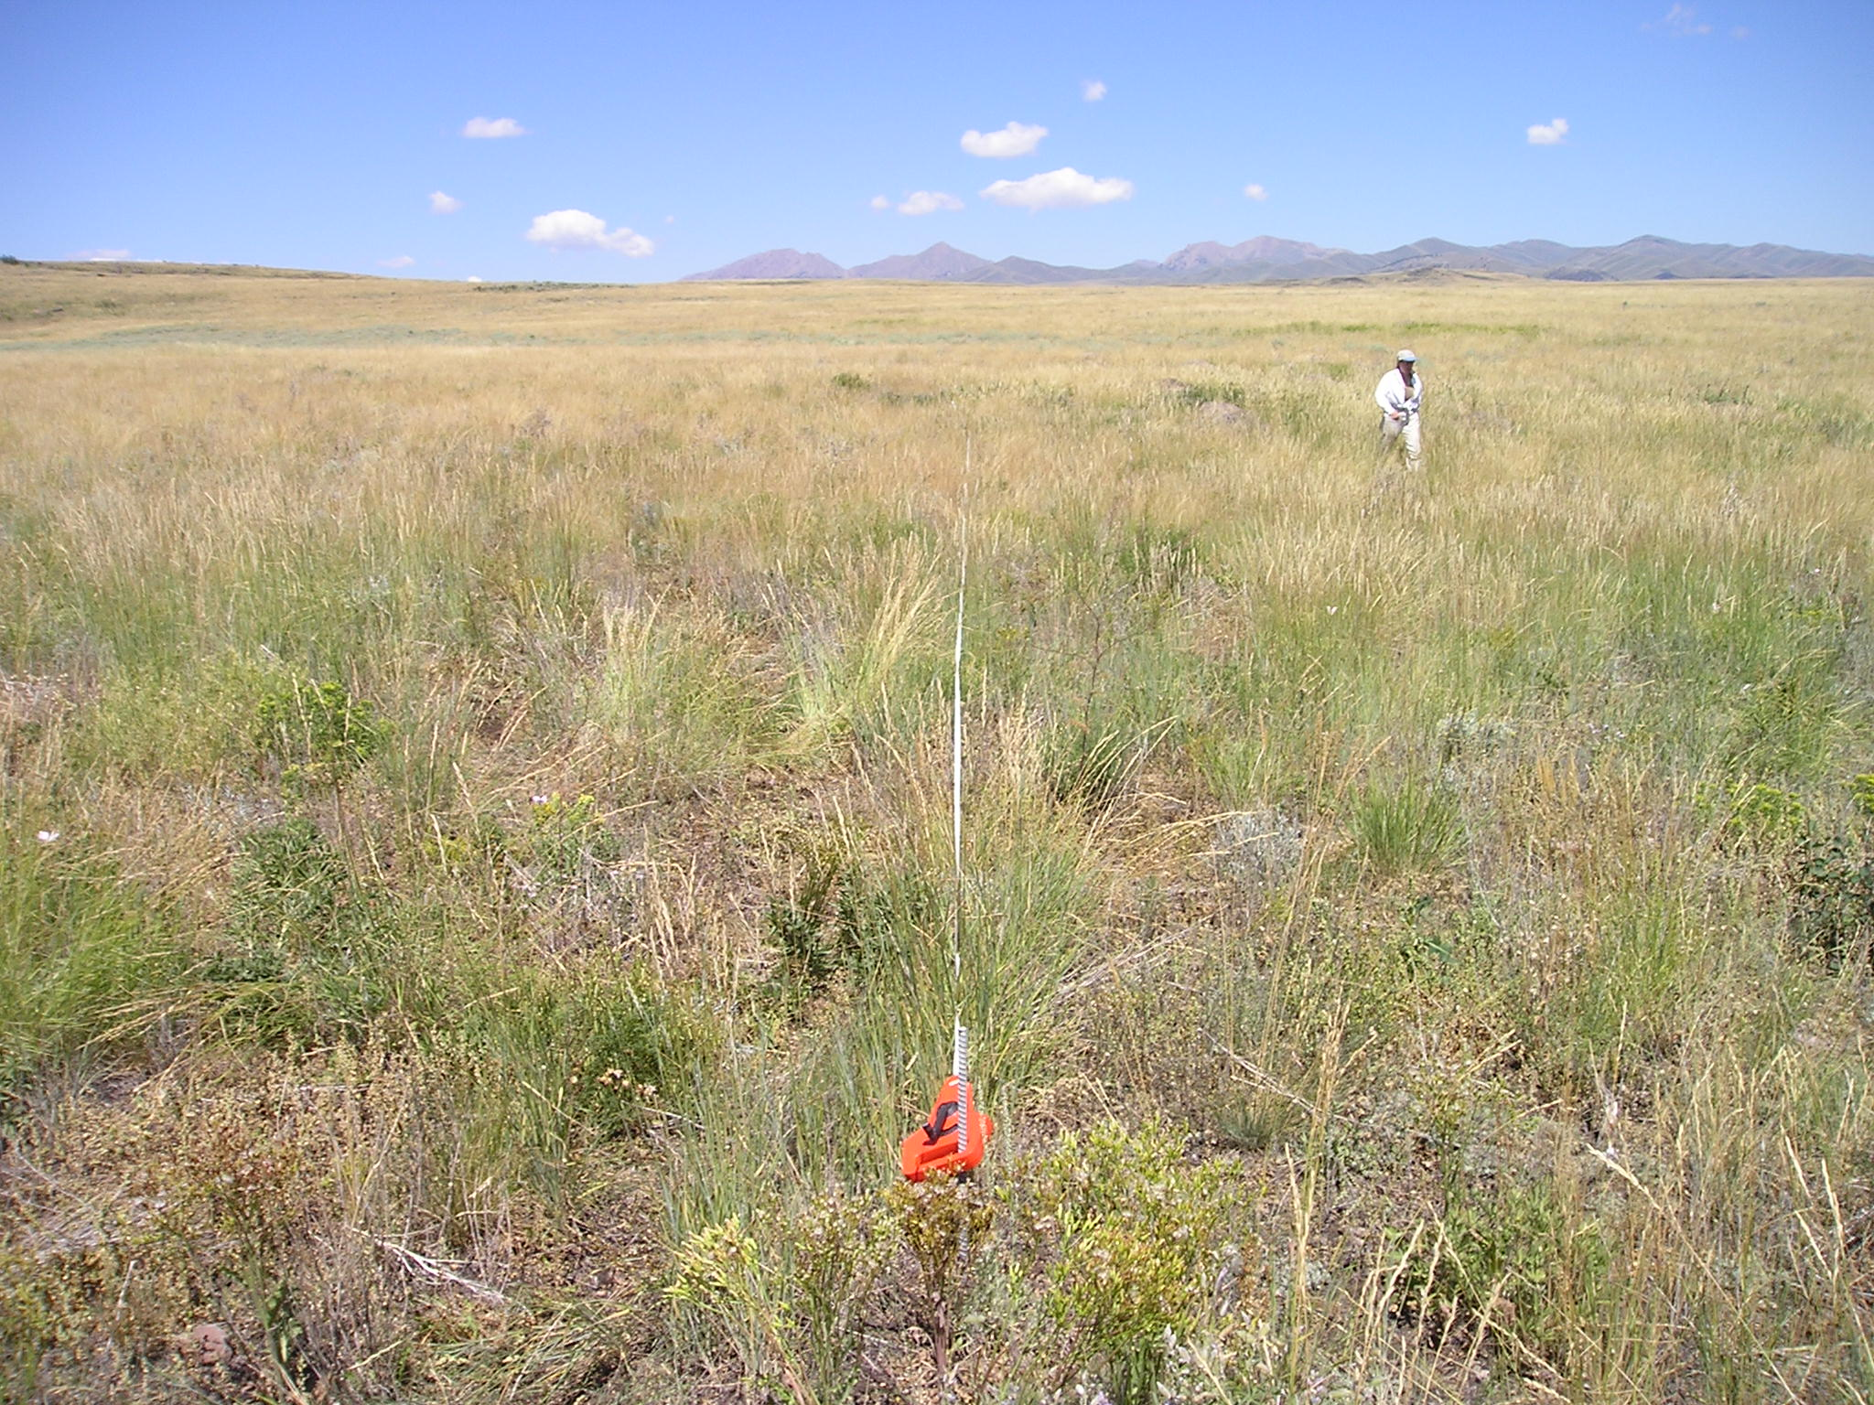
#13
800 lbs/acre
Notes:
B12-21 Loamy 16-22” ecological site dominated by ARTRV/FEID (burned in 2003)
Production estimated at 800 lbs/acre

Slide 38
Loamy 16-22” precipitation ecological site that burned in 2003.
Plant community is dominated by ARTRV/FEID (mountain big sagebrush and Idaho fescue).
Medicine Lodge
area, 20 miles NW
of Dubois, ID.

Slide 39
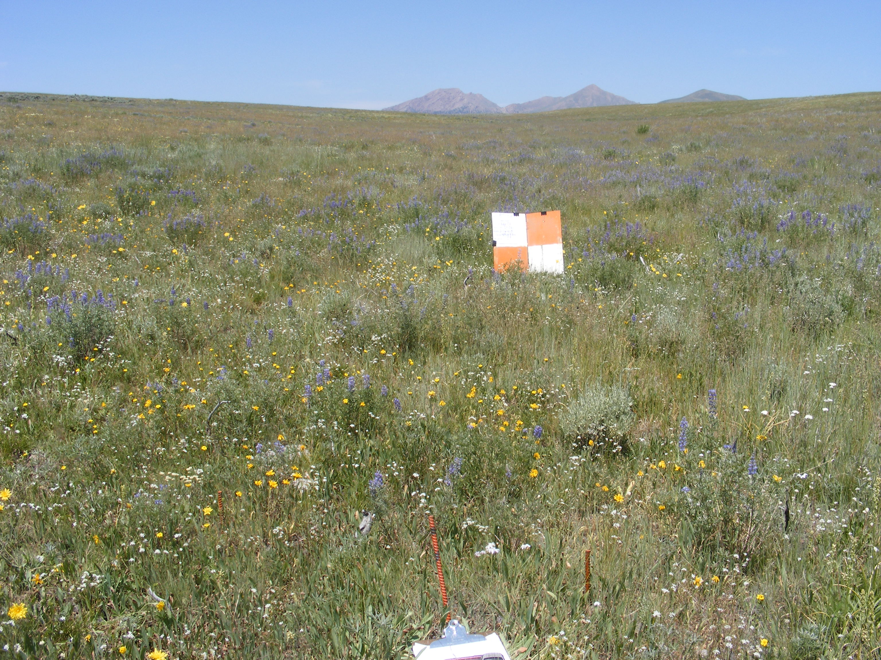
#14
700 lbs/acre
Notes:
B12-21 Loamy 16-22” ecological site ARTRV/FEID, burned in 2003
Production estimated at 700 lbs/acre

Slide 40
A Special Thank You to
Juley Hankins Smith with the Upper Snake BLM Field Office for the materials and photos used in this study guide

