Slide 1


Biomass Production Estimation

Slide 2
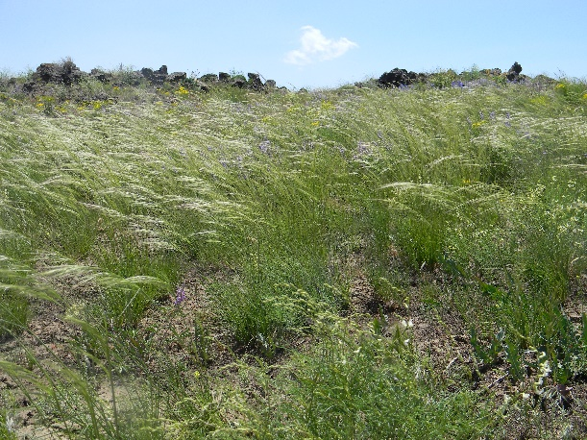
What is biomass?
Biomass or yearly production is the weight of the aboveground parts of plants per unit area
  It Includes the current year’s growth of:
    Herbaceous biomass
    Woody plant biomass
    Herbaceous plants: Forbs, grasses, and grass-likes
    Woody plants: Leaves, stems, flowers, seedheads, and fruits

Slide 3
How do we measure biomass?
A site is selected to represent the plant community you wish to measure
  This site should represents all aspects of the desired community
  The 2 ft x 2 ft hoop is randomly placed the over the desired area
    Placing the circle randomly prevents bias data
      Clip the total herbaceous biomass and weigh it
      Clip the total woody biomass and weigh it
      Only weigh the current year’s growth for both herbaceous and woody plants
        Take note that current year’s growth may be “browned up” depending on what time of year it is, precipitation that year, etc.
    The biomass is measured in grams and then multiplied by 20 to get lbs/acre

Slide 4
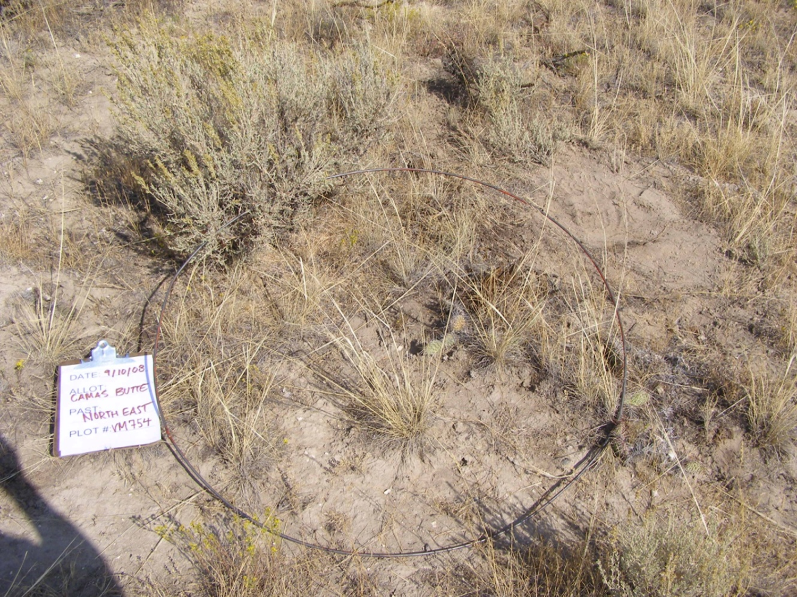
Example of placed hoop
- Note the herbaceous biomass and
shrub biomass

Slide 5
Why do we estimate biomass?
Determine available forage – How long can I graze?
Fuel Loads – How hot will a fire burn?
Erosion stability – Low biomass can mean high erosion
Wildlife habitat and cover – Nesting and rearing young
Trends – Is the land and species composition improving or getting worse?
Keep records – You never know when you might have to prove something

Slide 6
Why do we estimate biomass?
Rangelands are classified based on the production, plant types, soil, and precipitation
These sites are called “Ecological Site Descriptions” or ESDs
They are provided by the NRCS
Managers use these descriptions to estimate the health of rangeland sites
ESDs give the estimated biomass production of each site – even down to specific species
This helps managers know if the range health trend is going up or down

Slide 7
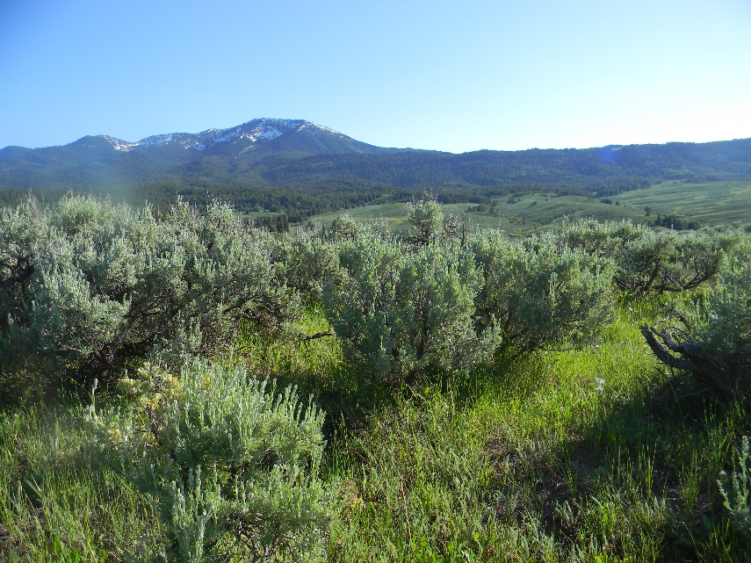
Why do we use “Dry Weight?”
All plants are made of water
Water is not included in living plant biomass
Water doesn’t burn in a fire and does not nutritionally benefit animals (in terms of providing energy)
Water content can vary based on the yearly precipitation and is not consistent
Generally biomass estimation is
done late in the year after plants
are done growing and flowering
Plant biomass can be dried using a
drying oven

Slide 8
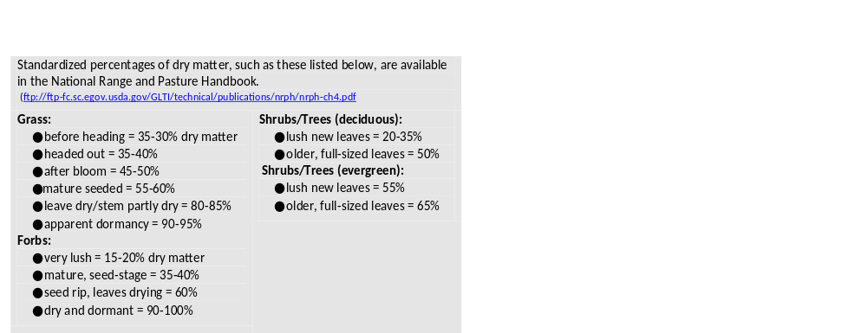
How much is water?

Slide 9
What is “Available Forage?”
When you are estimating forage, not all grass and plants are “available” to the grazing animal
Grasses and forbs that are under shrubs, on steep hillsides, or otherwise out of reach for animals are not available
Think like a cow – If you had to stick your soft nose in a thorny bush would you want that grass?
Available forage is only what is accessible to the grazing animal

Slide 10
WNRCDE – Biomass Estimation Event
For the WNRCDE field event, the area will be designated for you with the 2 ft x 2 ft hoop already placed
Your job is to visually estimate the lbs/acre of biomass based on what is in the hoop – you don’t clip!
After the event the biomass will be clipped for the correct production estimate
You will be asked to categorize the biomass into one of the following:
  0-400 lbs/acre
  400-800 lbs/acre
  800-1200 lbs/acre
  1200-1600 lbs/acre
  >1600 lbs/acre

Slide 11
Tips for Success
Don’t think about it too hard!
  If it doesn’t look like there is a lot of biomass there probably isn’t
Look at the plant types
  Grasses weigh less than shrubs and forbs weigh less than grasses (most of the time)
  Look at the community around you – The 2 ft x 2 ft hoop should be representative of the whole community

Slide 12
A Special Thank You to
Juley Hankins Smith with the Upper Snake BLM Field Office for the materials and photos used in this study guide.

